Slide 1
Task 1: LunchBox
Author: Ken Sung

Slide 2

Problem
Input:
N lunch boxes,
m schools asking for k₁, k₂, …, k_{m} lunch boxes.
Rule: We give either 0 or k_{i} lunch boxes to the i^{th} school.
Output: maximum number of schools that can receive lunch boxes.
N=4
Maximum No. of schools: 2
k₁=1
k₂=4
k₃=2

Slide 3
Solution
Greedy algorithm: Distribute the lunch boxes to the school requesting smaller number of lunch boxes first.
Sort the schools from small to big. O(m log m) time
Distribute the lunch box O(N) time
Report the number of schools
N=4
Maximum No. of schools: 2
k₁=1
k₂=4
k₃=2

Slide 4
Task 2: Fabric
Author: Mark Theng

Slide 5
Problem
Input:
A N×M cloth with some hole (hole is represented by 1)
An area threshold K
Output:
The number of ways to cut a rectangle such that the area is at least K and there is no hole
Example: 2×4 cloth, K=3
Two rectangles of size 3
One rectangle of size 4
Total: 3 rectangles of size 3!
1 | 0 | 0 | 0
0 | 0 | 0 | 1

Slide 6
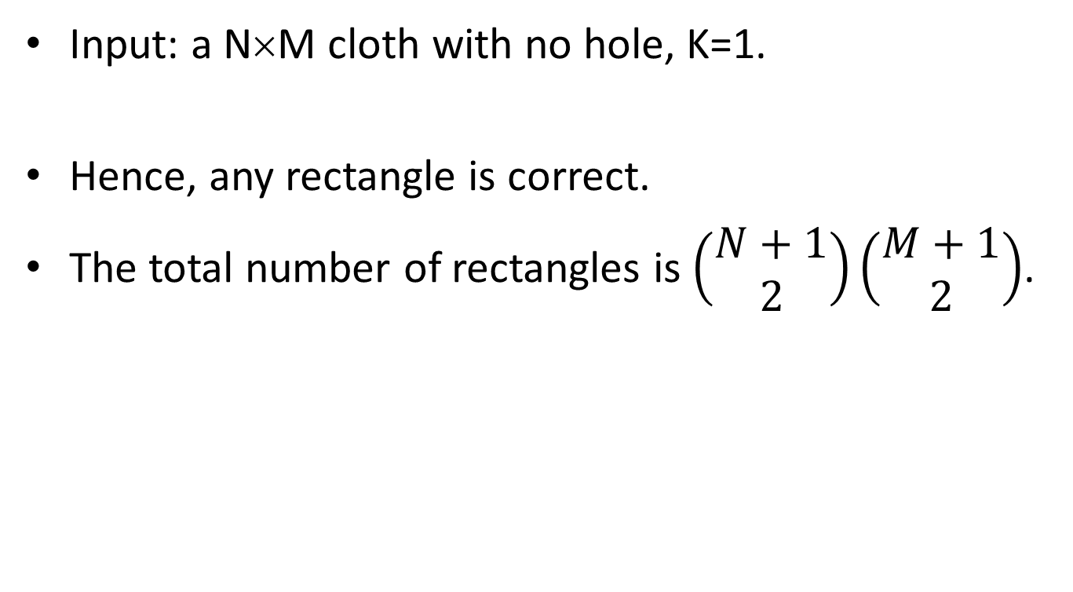
Subtask 1
Input: a N×M cloth with no hole, K=1.
Hence, any rectangle is correct.
The total number of rectangles is $\left(\begin{matrix}N+1 \\ 2\end{matrix}\right)\left(\begin{matrix}M+1 \\ 2\end{matrix}\right)$.
x₁
x₂
y₁
y₂

Slide 7
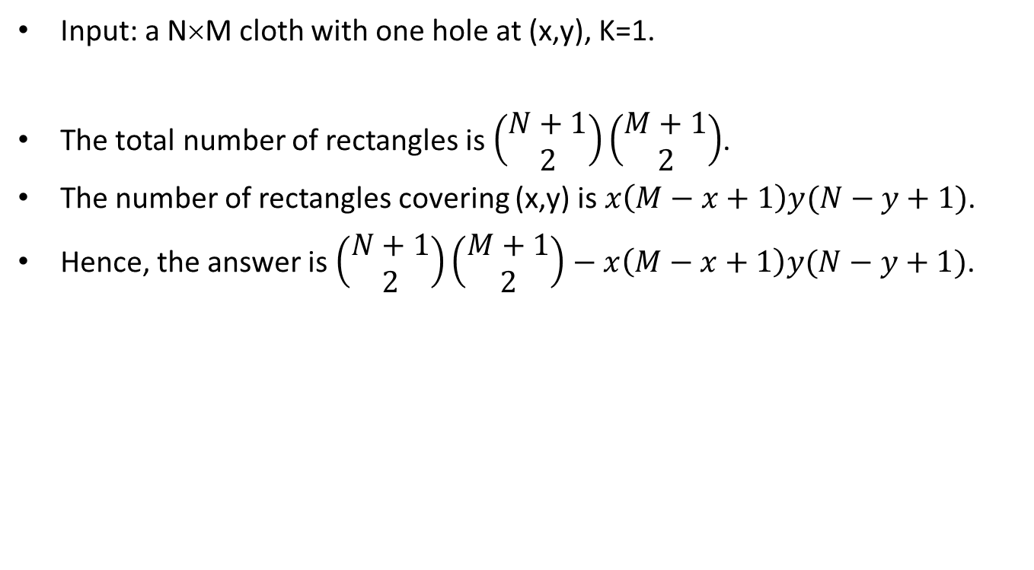
Subtask 2
Input: a N×M cloth with one hole at (x,y), K=1.
The total number of rectangles is $\left(\begin{matrix}N+1 \\ 2\end{matrix}\right)\left(\begin{matrix}M+1 \\ 2\end{matrix}\right)$.
The number of rectangles covering (x,y) is $x\left(M−x+1\right)y(N−y+1)$.
Hence, the answer is $\left(\begin{matrix}N+1 \\ 2\end{matrix}\right)\left(\begin{matrix}M+1 \\ 2\end{matrix}\right)−x\left(M−x+1\right)y(N−y+1)$.
x₁
x
x₂
y₁
y
y₂

Slide 8
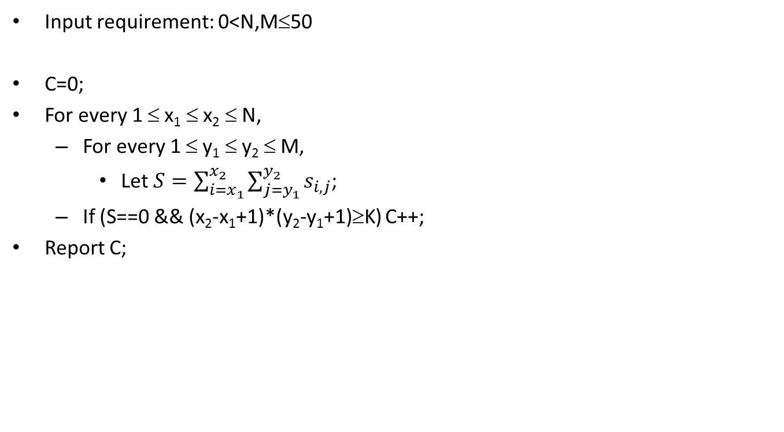
Subtask 3
Input requirement: 0<N,M≤50
C=0;
For every 1 ≤ x₁ ≤ x₂ ≤ N,
For every 1 ≤ y₁ ≤ y₂ ≤ M,
Let $S=\sum_{i=x_{1}}^{x_{2}}{\sum_{j=y_{1}}^{y_{2}}{s_{i,j}}}$;
If (S==0 && (x₂-x₁+1)*(y₂-y₁+1)≥K) C++;
Report C;
O(N³M³) time.
y₁
y₂
1 | 0 | 1 | 0 | 0 | 0 | 0 | 0 | 0 | 0
0 | 1 | 0 | 0 | 1 | 0 | 0 | 1 | 0 | 0
0 | 0 | 0 | 0 | 0 | 0 | 0 | 1 | 0 | 0
0 | 0 | 1 | 0 | 0 | 0 | 0 | 0 | 0 | 1
0 | 0 | 0 | 0 | 0 | 0 | 0 | 0 | 0 | 0
x₁
x₂

Slide 9
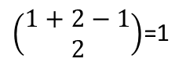
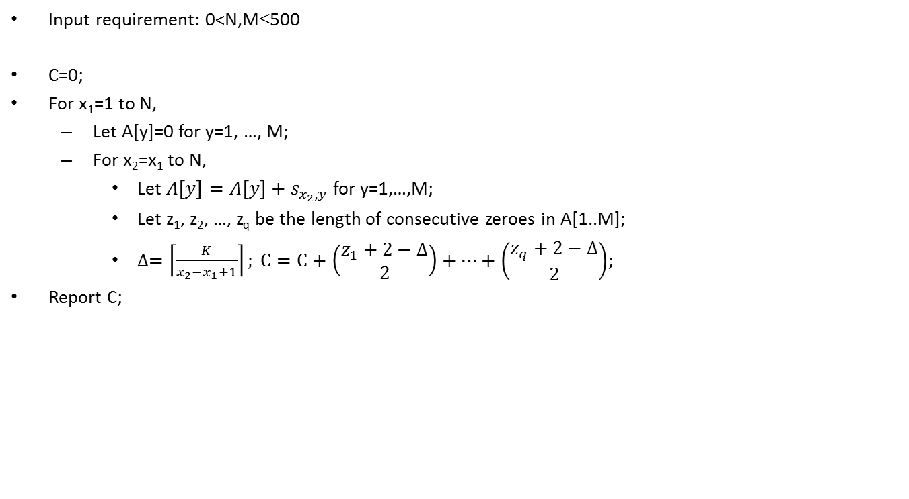
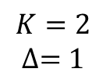
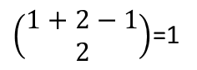
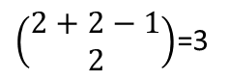
Subtask 4
Input requirement: 0<N,M≤500
C=0;
For x₁=1 to N,
Let A[y]=0 for y=1, …, M;
For x₂=x₁ to N,
Let $A\left[y\right]=A\left[y\right]+s_{x_{2},y}$ for y=1,…,M;
Let z₁, z₂, …, z_{q} be the length of consecutive zeroes in A[1..M];
$∆=\left\lceil \frac{K}{x_{2}−x_{1}+1}\right\rceil ; C=C+\left(\begin{matrix}z_{1}+2−∆ \\ 2\end{matrix}\right)+…+\left(\begin{matrix}z_{q}+2−∆ \\ 2\end{matrix}\right)$;
Report C;
O(N²M) time.
1 | 0 | 1 | 0 | 0 | 0 | 0 | 0 | 0 | 0
0 | 1 | 0 | 0 | 1 | 0 | 0 | 1 | 0 | 0
0 | 0 | 0 | 0 | 0 | 0 | 0 | 1 | 0 | 0
0 | 0 | 1 | 0 | 0 | 0 | 0 | 0 | 0 | 1
0 | 0 | 0 | 0 | 0 | 0 | 0 | 0 | 0 | 0
x₁
x₂
A
0 | 1 | 1 | 0 | 1 | 0 | 0 | 2 | 0 | 1
$$K=2$$
$$∆=1$$
$\left(\begin{matrix}1+2−1 \\ 2\end{matrix}\right)$=1
$\left(\begin{matrix}1+2−1 \\ 2\end{matrix}\right)$=1
$\left(\begin{matrix}2+2−1 \\ 2\end{matrix}\right)$=3
$\left(\begin{matrix}1+2−1 \\ 2\end{matrix}\right)$=1

Slide 10
Subtask 5
Input requirement: 0<N,M≤2000 and K=1.
Denote T_{x,y} be the number of rectangles whose lowest right corner is (x,y).
The blue cells (called limiters) are the first ‘1’ just above the y^{th} row.
The staircase shape green region indicates the feasible region for all rectangles whose lowest right corner is (x,y).
T_{x,y} equals the number of green cells.
For example, T_{5,7} = 3+6+4+5 = 18.
1 | 2 | 3 | 4 | 5 | 6 | 7 | 8 | 9 | 10
1
2
3
4
5
1 | 0 | 1 | 0 | 0 | 1 | 0 | 0 | 0 | 0
0 | 1 | 0 | 0 | 1 | 0 | 0 | 1 | 0 | 0
0 | 0 | 0 | 0 | 0 | 0 | 0 | 1 | 0 | 0
0 | 0 | 1 | 0 | 0 | 0 | 0 | 0 | 0 | 1
0 | 0 | 0 | 0 | 0 | 0 | 0 | 0 | 0 | 0
The shape for (7,5) =
(3,4)³, (5,2)⁶, (6,1)⁴, (7,0)⁵

Slide 11
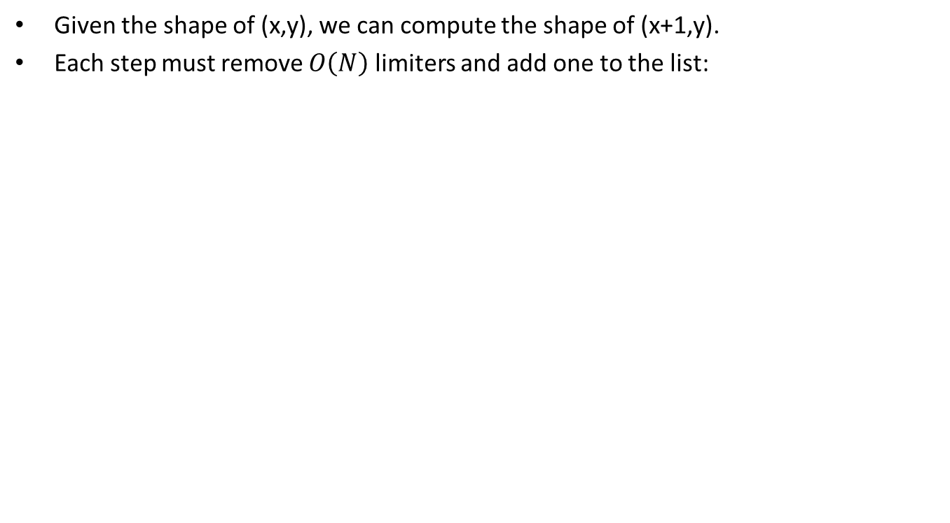
Subtask 5
Given the shape of (x,y), we can compute the shape of (x+1,y).
Each step must remove $O\left(N\right)$ limiters and add one to the list:
1 | 2 | 3 | 4 | 5 | 6 | 7 | 8 | 9 | 10
1
2
3
4
5
1 | 0 | 1 | 0 | 0 | 1 | 0 | 0 | 0 | 0
0 | 1 | 0 | 0 | 1 | 0 | 0 | 1 | 0 | 0
0 | 0 | 0 | 0 | 0 | 0 | 0 | 1 | 0 | 0
0 | 0 | 1 | 0 | 0 | 0 | 0 | 0 | 0 | 1
0 | 0 | 0 | 0 | 0 | 0 | 0 | 0 | 0 | 0
The shape for (7,5) =
(3,4)³, (5,2)⁶, (6,1)⁴, (7,0)⁵
T_{7,5}=3+6+4+5=18
Remove (5,2)⁶, (6,1)⁴, (7,0)⁵
Insert (8,3)¹⁰
1 | 2 | 3 | 4 | 5 | 6 | 7 | 8 | 9 | 10
1
2
3
4
5
1 | 0 | 1 | 0 | 0 | 1 | 0 | 0 | 0 | 0
0 | 1 | 0 | 0 | 1 | 0 | 0 | 1 | 0 | 0
0 | 0 | 0 | 0 | 0 | 0 | 0 | 1 | 0 | 0
0 | 0 | 1 | 0 | 0 | 0 | 0 | 0 | 0 | 1
0 | 0 | 0 | 0 | 0 | 0 | 0 | 0 | 0 | 0
The shape for (8,5) =
(4,3)³, (8,3)¹⁰
T_{8,5}= 3+10=13

Slide 12
Subtask 5
C=0;
For y = 1 to M
Update the limiters L[i] (the first ‘1’ just above the y^{th} row) in O(N) time;
Set S be empty stack;
For x = 1 to N
Update the shape S by removing a list of limiters (j, L[j]) such that L[j]<L[x] and insert (x, L[x]) into S;
Compute T_{x,y} from T_{x-1,y};
C = C + T_{x,y};
Report C;
For the y^{th} row, the time required to update the shape S and compute T_{x,y} is O(N). There are M rows. The time complexity is O(NM).

Slide 13
Subtask 6
Input requirement: 0<N,M≤2000.
We use the same algorithm in subtask 5.
Moreover, we need to mask all rectangles of size at most K.
For example, for (7,5), if K=5, we need to mask 10 entries (gary entries).
We don’t describe the detail due to time limit.
1 | 2 | 3 | 4 | 5 | 6 | 7 | 8 | 9 | 10
1
2
3
4
5
1 | 0 | 1 | 0 | 0 | 1 | 0 | 0 | 0 | 0
0 | 1 | 0 | 0 | 1 | 0 | 0 | 1 | 0 | 0
0 | 0 | 0 | 0 | 0 | 0 | 0 | 1 | 0 | 0
0 | 0 | 1 | 0 | 0 | 0 | 0 | 0 | 0 | 1
0 | 0 | 0 | 0 | 0 | 0 | 0 | 0 | 0 | 0

Slide 14
Task 3: Rock Climbing
Author: Gan Wei Liang

Slide 15
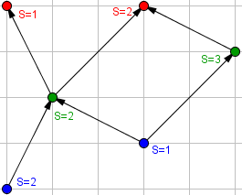
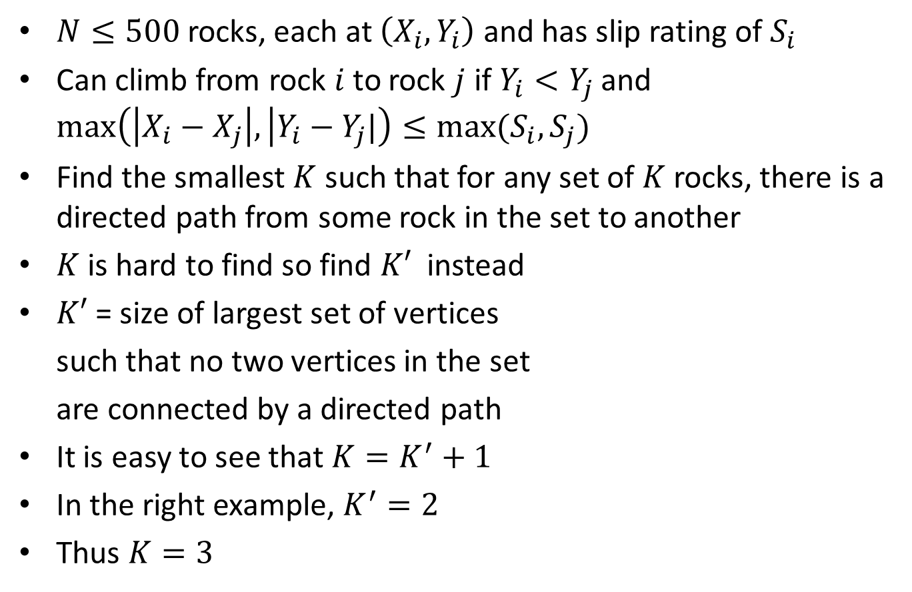
Abridged Problem Statement
$N≤500$rocks, each at $\left(X_{i},Y_{i}\right)$ and has slip rating of $S_{i}$
Can climb from rock $i$ to rock $j$ if $Y_{i}<Y_{j}$ and $\max\left(\left|X_{i}−X_{j}\right|, | Y_{i}−Y_{j}|\right)≤max⁡(S_{i},S_{j})$
Find the smallest $K$ such that for any set of $K$ rocks, there is a directed path from some rock in the set to another
$K$ is hard to find so find $K′$ instead
$K′$ = size of largest set of vertices
such that no two vertices in the set
are connected by a directed path
It is easy to see that $K=K^{′}+1$
In the right example, $K^{′}=2$
Thus $K=3$

Slide 16
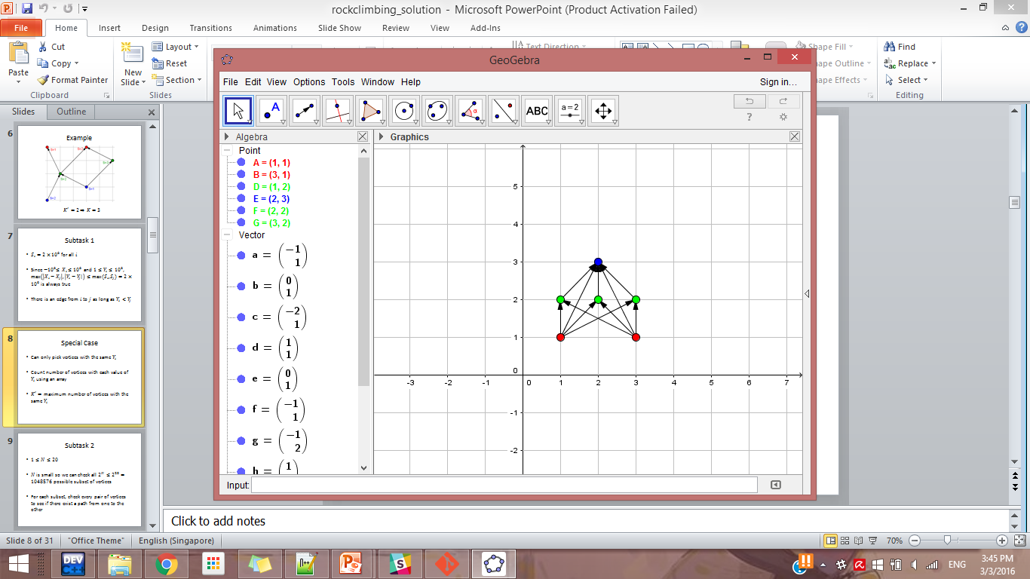
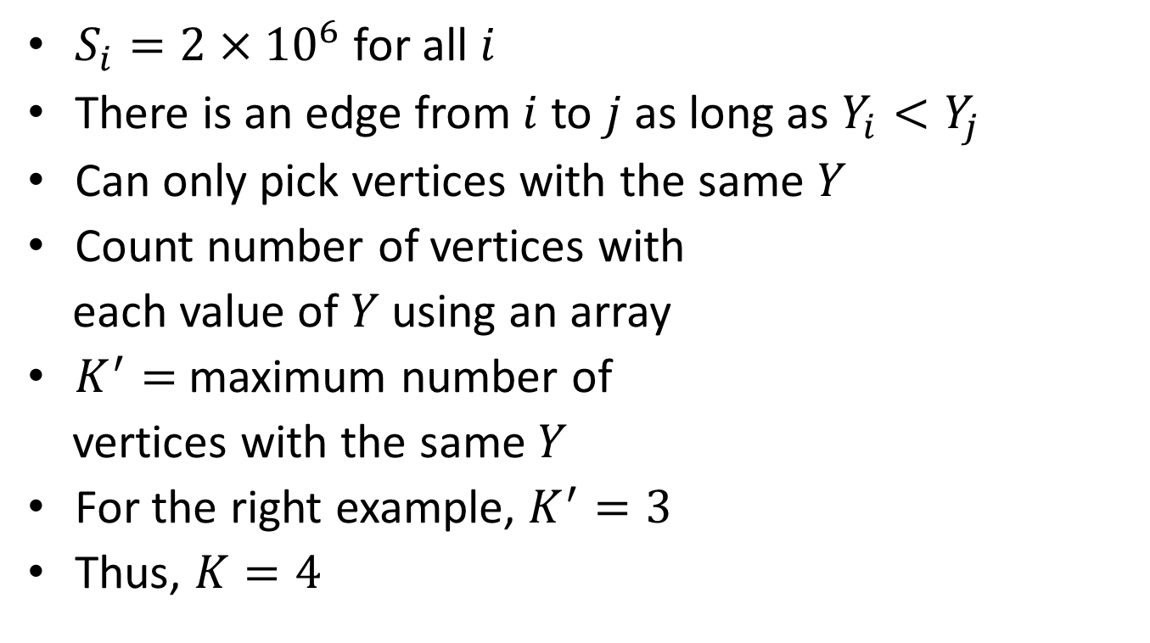
Subtask 1
$S_{i}=2×{10}^{6}$ for all $i$
There is an edge from $i$ to $j$ as long as $Y_{i}<Y_{j}$
Can only pick vertices with the same $Y$
Count number of vertices with
each value of $Y$using an array
$K^{′}=$ maximum number of
vertices with the same $Y$
For the right example, $K^{′}=3$
Thus, $K=4$

Slide 17
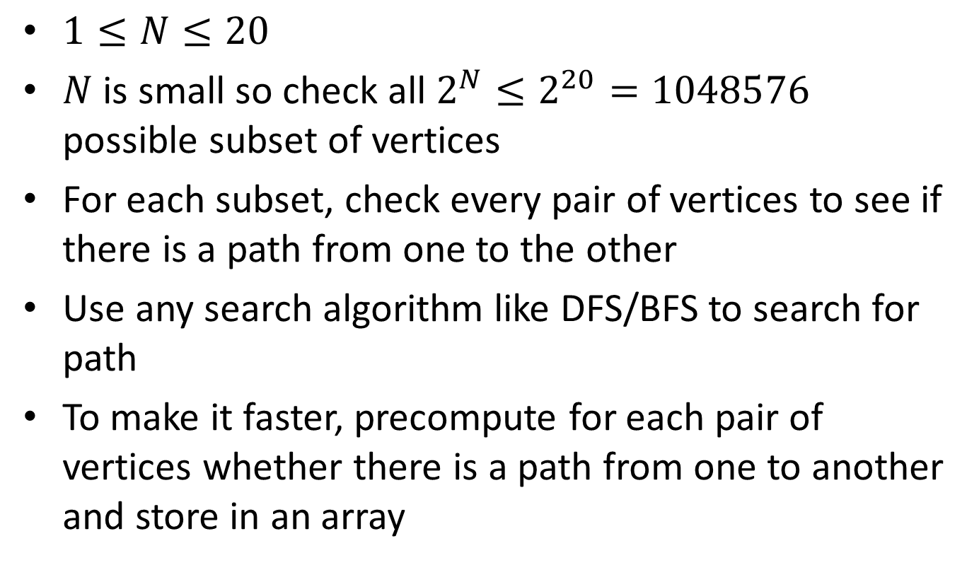
Subtask 2
$1≤N≤20$
$N$ is small so check all $2^{N}≤2^{20}=1048576$ possible subset of vertices
For each subset, check every pair of vertices to see if there is a path from one to the other
Use any search algorithm like DFS/BFS to search for path
To make it faster, precompute for each pair of vertices whether there is a path from one to another and store in an array

Slide 18
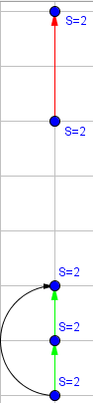
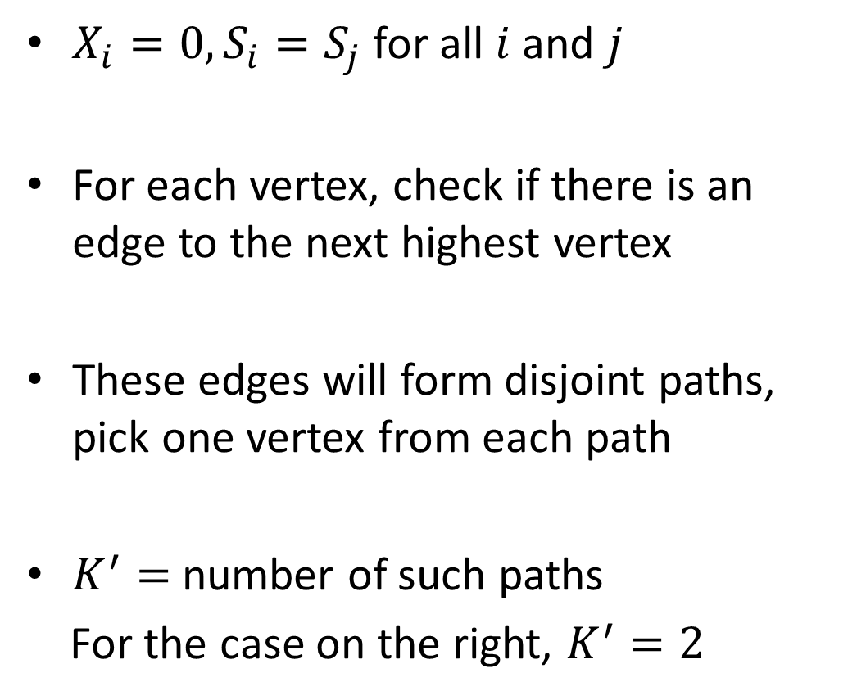
Subtask 3
$X_{i}=0,S_{i}=S_{j}$ for all $i$ and $j$
For each vertex, check if there is an edge to the next highest vertex
These edges will form disjoint paths, pick one vertex from each path
$K^{′}=$ number of such paths
For the case on the right, $K^{′}=2$

Slide 19
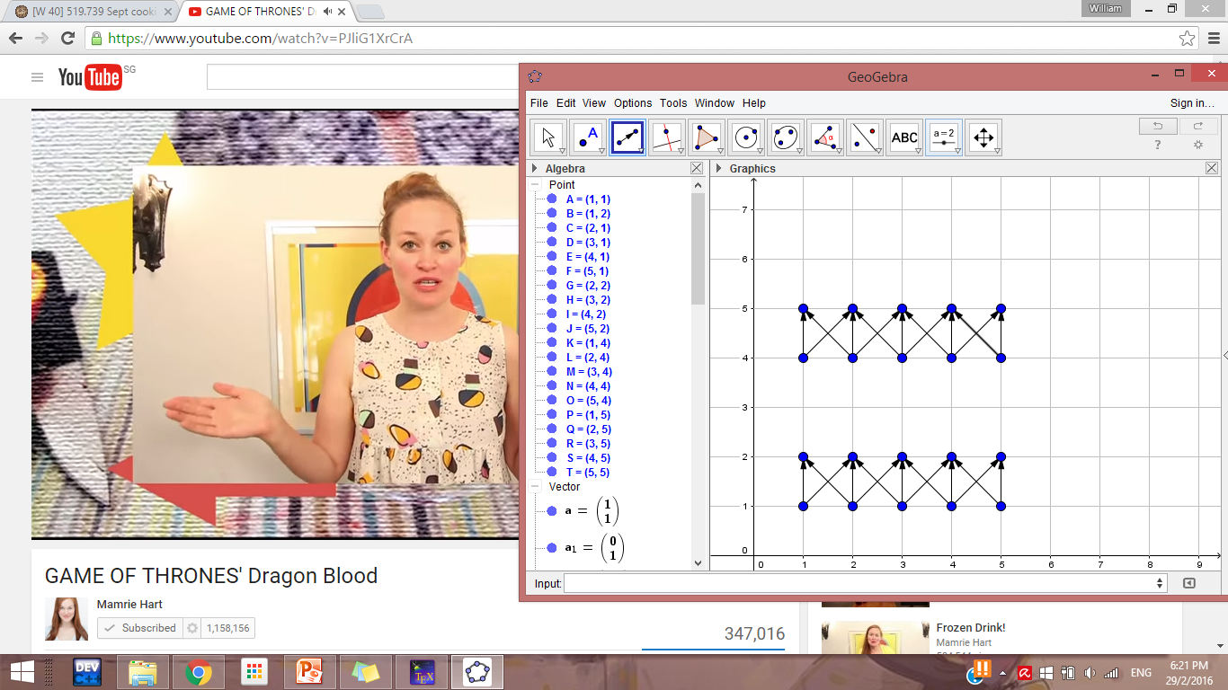
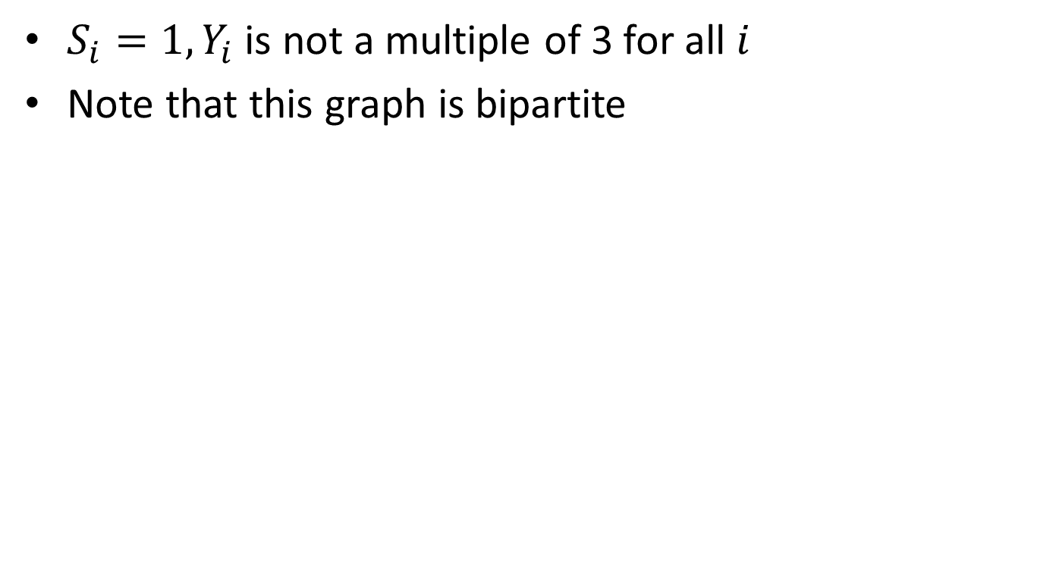
Subtask 4
$S_{i}=1,Y_{i}$ is not a multiple of 3 for all $i$
Note that this graph is bipartite

Slide 20
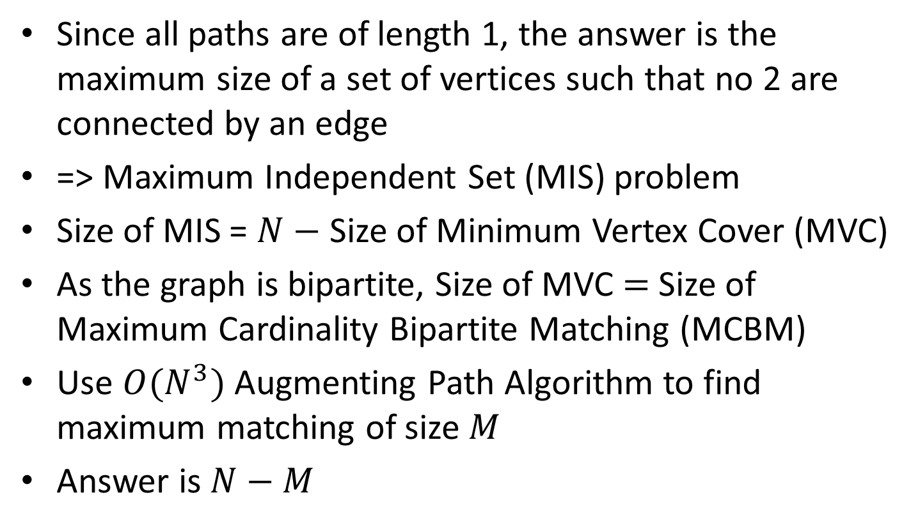
Algorithm
Since all paths are of length 1, the answer is the maximum size of a set of vertices such that no 2 are connected by an edge
=> Maximum Independent Set (MIS) problem
Size of MIS = $N−$ Size of Minimum Vertex Cover (MVC)
As the graph is bipartite, Size of MVC $=$Size of Maximum Cardinality Bipartite Matching (MCBM)
Use $O(N^{3})$ Augmenting Path Algorithm to find maximum matching of size $M$
Answer is $N−M$

Slide 21
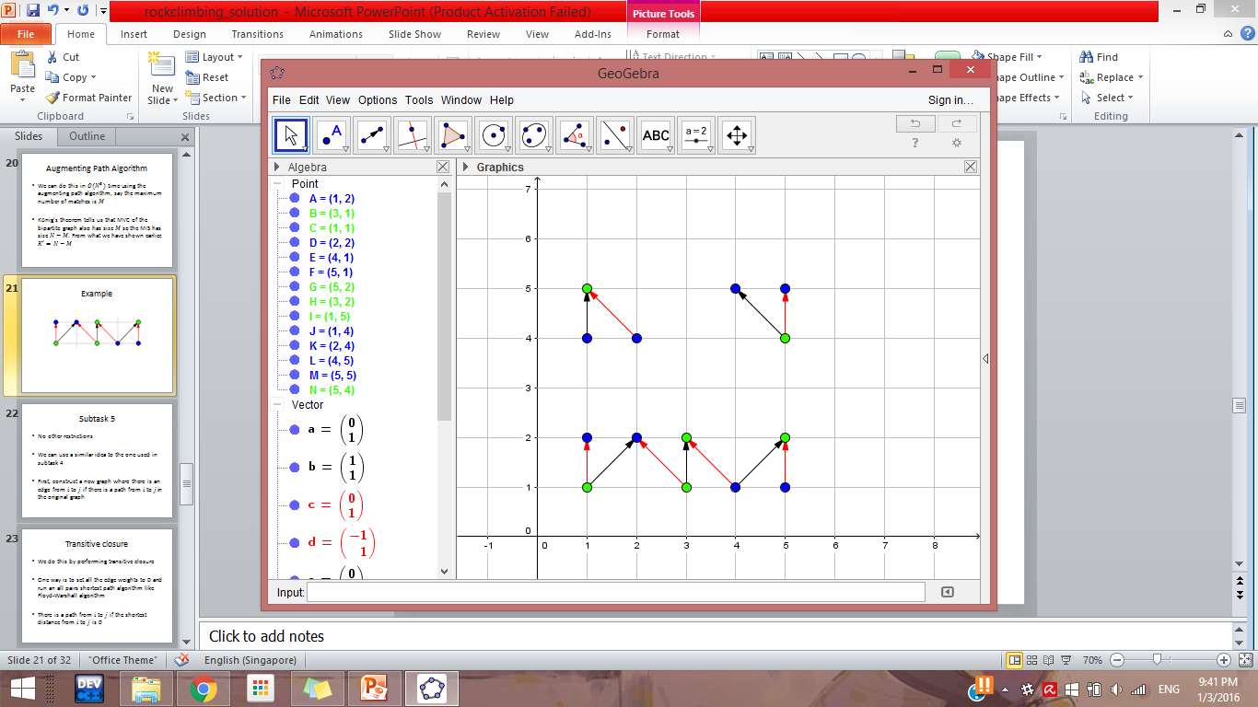
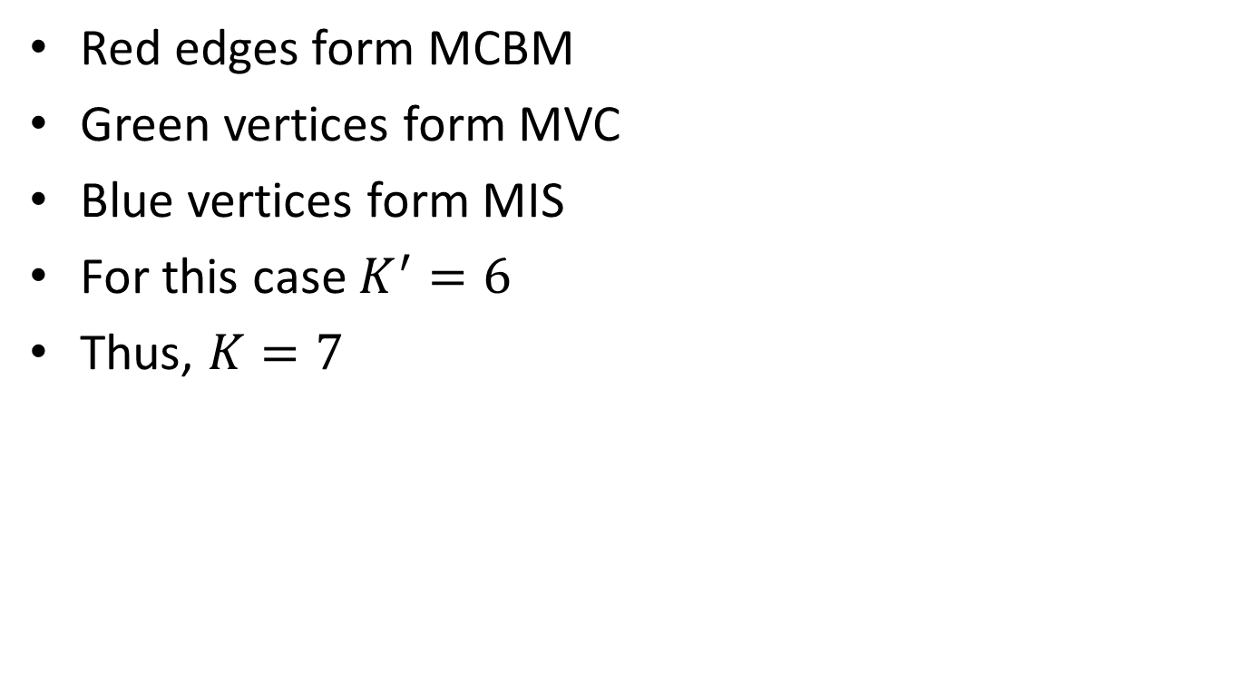
Example
Red edges form MCBM
Green vertices form MVC
Blue vertices form MIS
For this case $K^{′}=6$
Thus, $K=7$

Slide 22
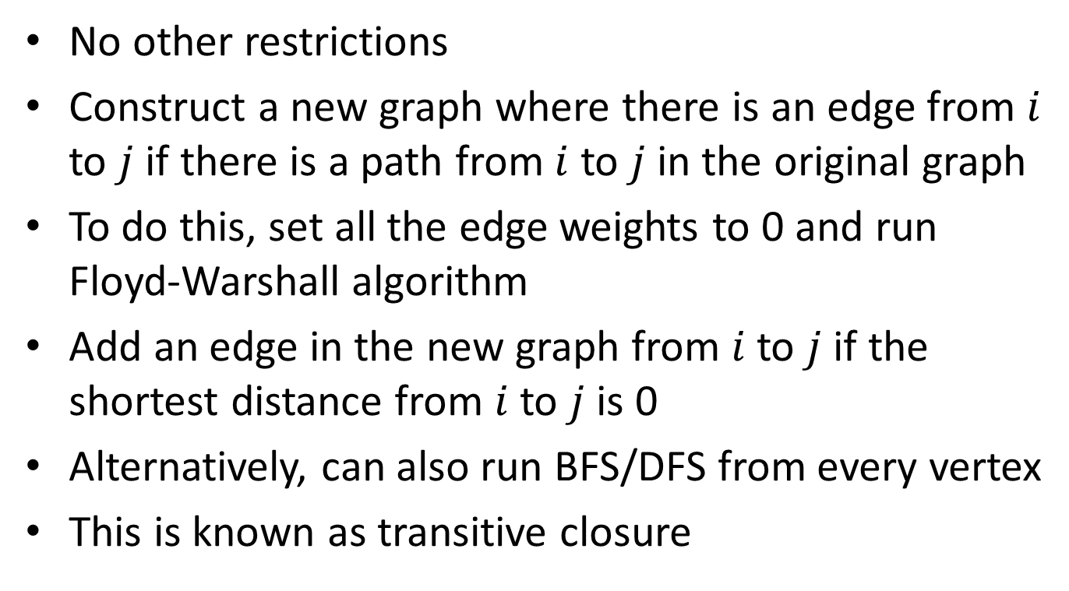
Subtask 5
No other restrictions
Construct a new graph where there is an edge from $i$ to $j$ if there is a path from $i$ to $j$ in the original graph
To do this, set all the edge weights to 0 and run Floyd-Warshall algorithm
Add an edge in the new graph from $i$ to $j$ if the shortest distance from $i$ to $j$ is 0
Alternatively, can also run BFS/DFS from every vertex
This is known as transitive closure

Slide 23
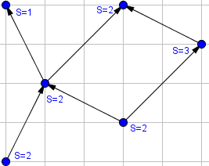
Example

Slide 24
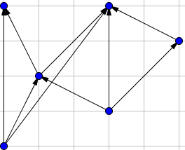
Transitive Closure

Slide 25
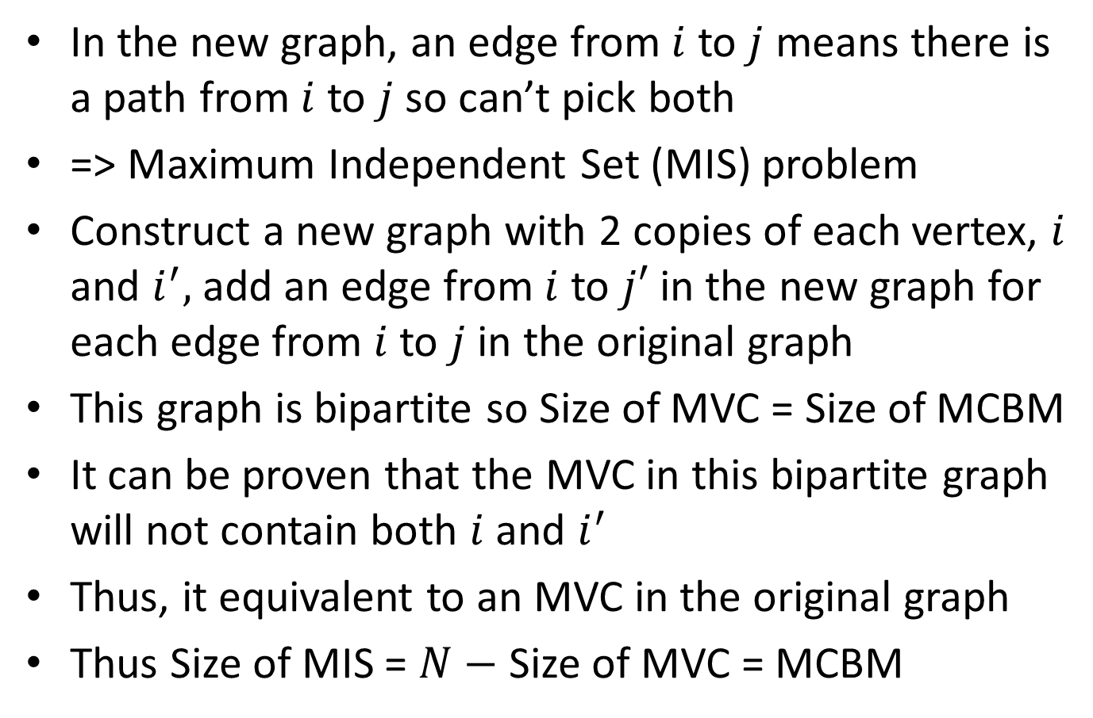
Algorithm
In the new graph, an edge from $i$ to $j$ means there is a path from $i$ to $j$ so can’t pick both
=> Maximum Independent Set (MIS) problem
Construct a new graph with 2 copies of each vertex, $i$ and $i^{′},$add an edge from $i$ to $j′$ in the new graph for each edge from $i$ to $j$ in the original graph
This graph is bipartite so Size of MVC = Size of MCBM
It can be proven that the MVC in this bipartite graph will not contain both $i$ and $i^{′}$
Thus, it equivalent to an MVC in the original graph
Thus Size of MIS = $N−$ Size of MVC = MCBM

Slide 26
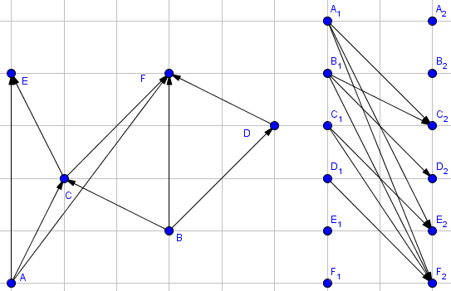
Bipartite Graph

Slide 27
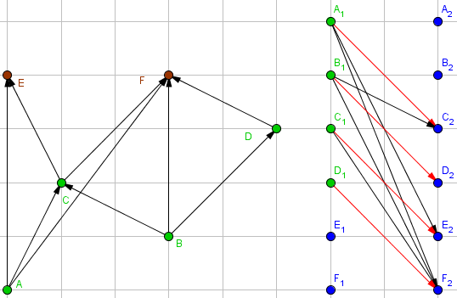
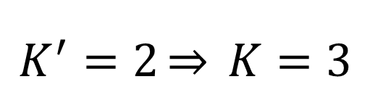
Bipartite Matching
$$K^{′}=2\underset{⇒}{} K=3$$

Slide 28
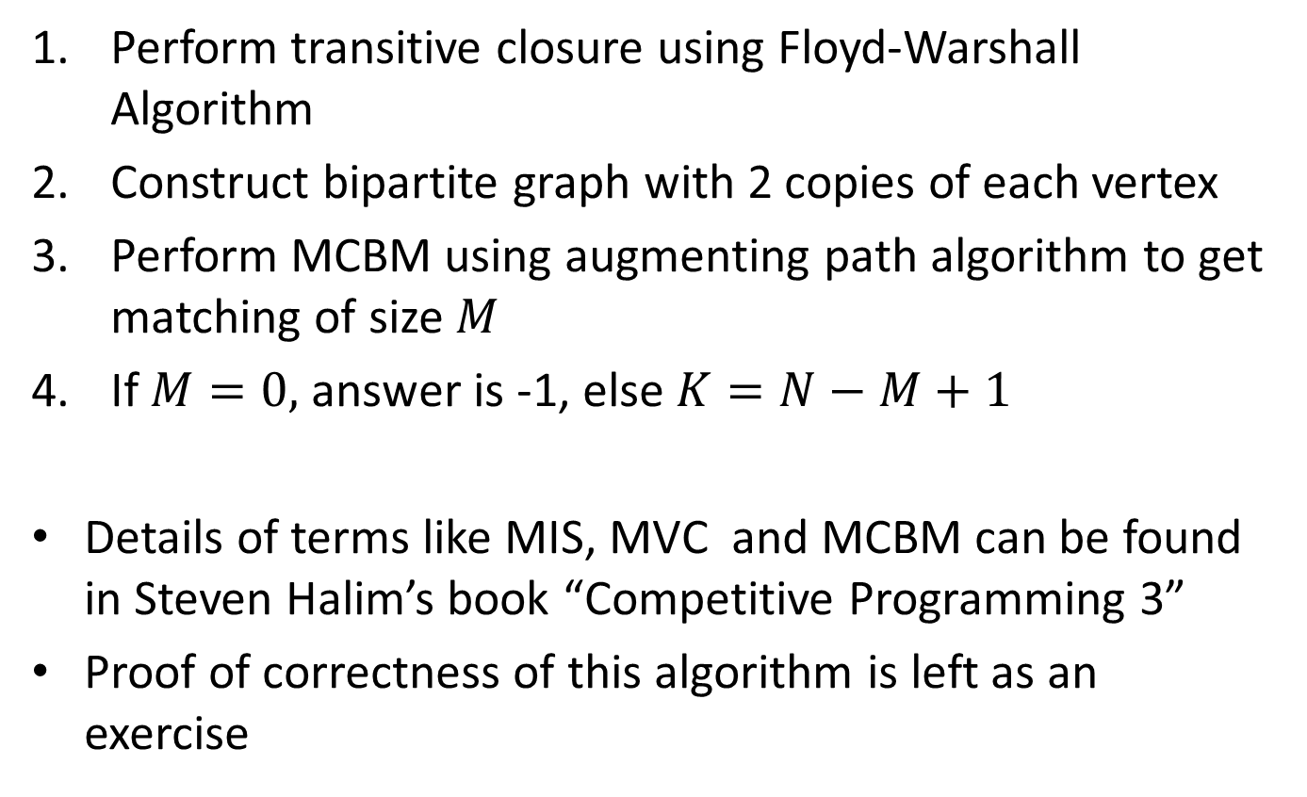
Conclusion
Perform transitive closure using Floyd-Warshall Algorithm
Construct bipartite graph with 2 copies of each vertex
Perform MCBM using augmenting path algorithm to get matching of size $M$
If $M=0,$ answer is -1, else $K=N−M+1$
Details of terms like MIS, MVC and MCBM can be found in Steven Halim’s book “Competitive Programming 3”
Proof of correctness of this algorithm is left as an exercise

Slide 29
Task 4: Panda Ski
Author: Gan Wei Liang

Slide 30
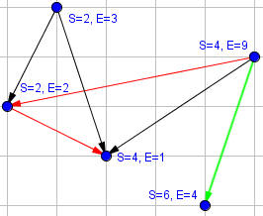
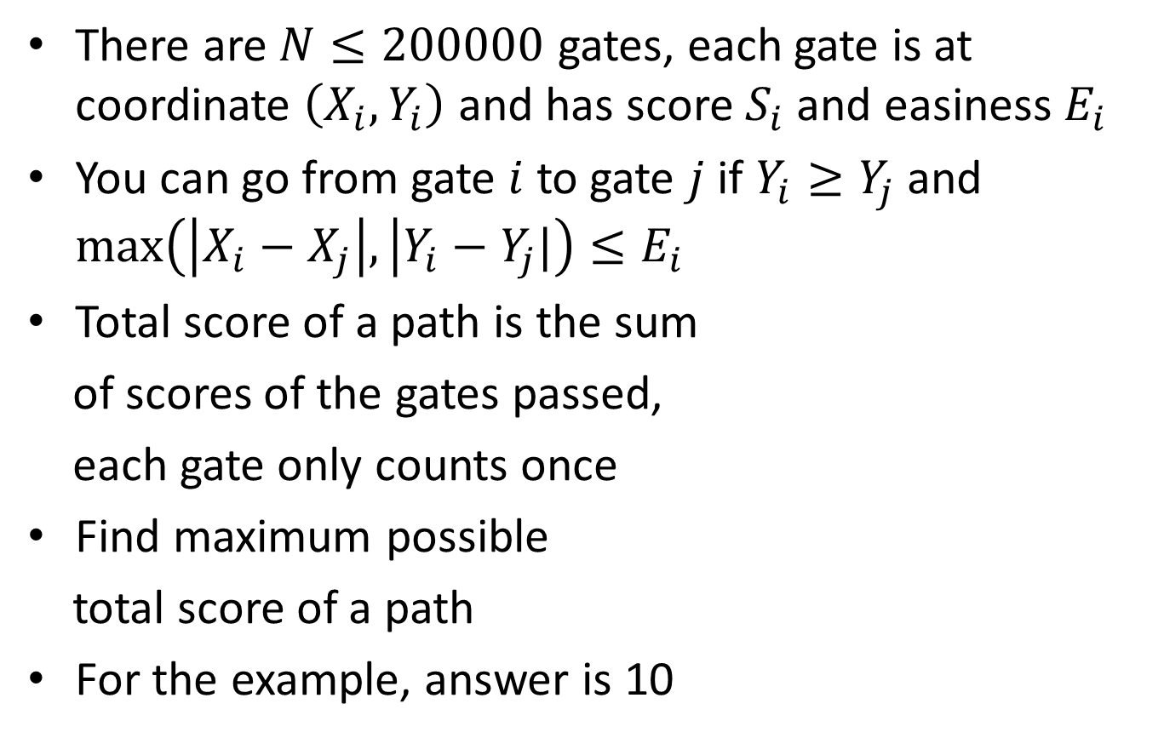
Abridged Problem Statement
There are $N≤200000$ gates, each gate is at coordinate $\left(X_{i},Y_{i}\right)$ and has score $S_{i}$ and easiness $E_{i}$
You can go from gate $i$ to gate $j$ if $Y_{i}≥Y_{j}$ and $\max\left(\left|X_{i}−X_{j}\right|, | Y_{i}−Y_{j}|\right)≤E_{i}$
Total score of a path is the sum
of scores of the gates passed,
each gate only counts once
Find maximum possible
total score of a path
For the example, answer is 10

Slide 31
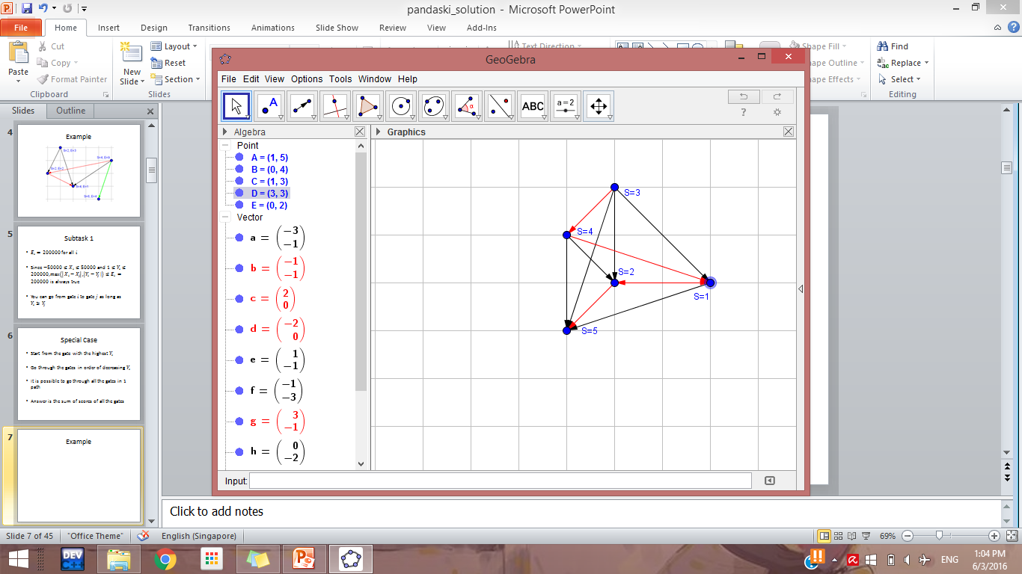
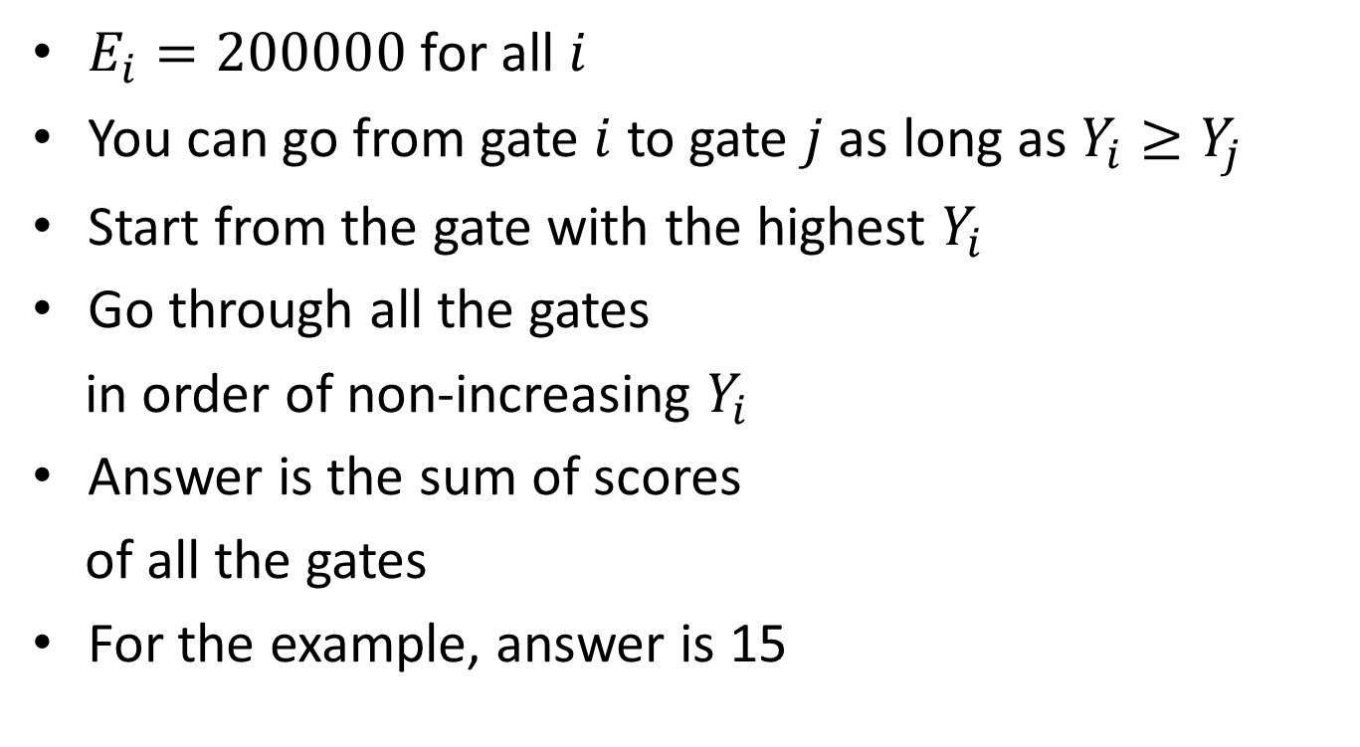
Subtask 1
$E_{i}=200000$for all $i$
You can go from gate $i$ to gate $j$ as long as $Y_{i}≥Y_{j}$
Start from the gate with the highest $Y_{i}$
Go through all the gates
in order of non-increasing $Y_{i}$
Answer is the sum of scores
of all the gates
For the example, answer is 15

Slide 32
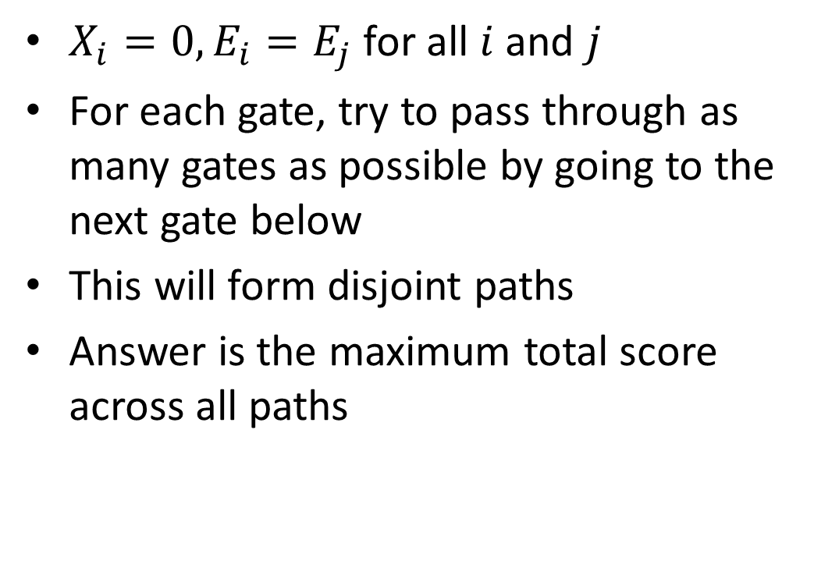
Subtask 2
$X_{i}=0,E_{i}=E_{j}$ for all $i$ and $j$
For each gate, try to pass through as many gates as possible by going to the next gate below
This will form disjoint paths
Answer is the maximum total score across all paths

Slide 33
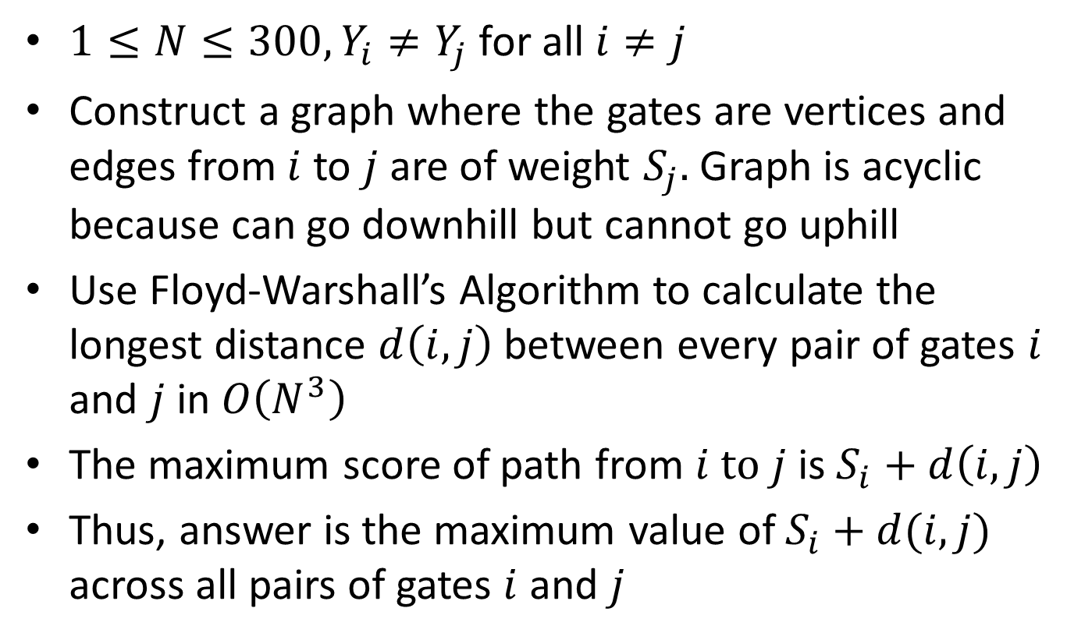
Subtask 3
$1≤N≤300, Y_{i}≠Y_{j}$ for all $i≠j$
Construct a graph where the gates are vertices and edges from $i$ to $j$ are of weight $S_{j}.$Graph is acyclic because can go downhill but cannot go uphill
Use Floyd-Warshall’s Algorithm to calculate the longest distance $d\left(i,j\right)$ between every pair of gates $i$ and $j$ in $O\left(N^{3}\right)$
The maximum score of path from $i to j$ is $S_{i}+d\left(i,j\right)$
Thus, answer is the maximum value of $S_{i}+d(i,j)$ across all pairs of gates $i$ and $j$

Slide 34
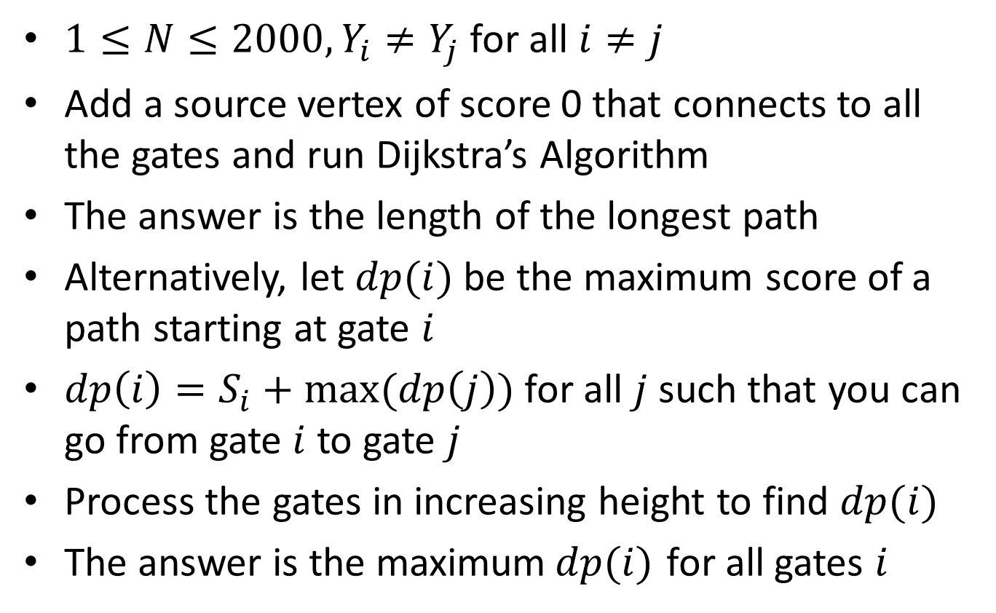
Subtask 4
$1≤N≤2000, Y_{i}≠Y_{j}$ for all $i≠j$
Add a source vertex of score 0 that connects to all the gates and run Dijkstra’s Algorithm
The answer is the length of the longest path
Alternatively, let $dp(i)$ be the maximum score of a path starting at gate $i$
$dp\left(i\right)=S_{i}+max⁡(dp\left(j\right))$ for all $j$ such that you can go from gate $i$ to gate $j$
Process the gates in increasing height to find $dp(i)$
The answer is the maximum$dp(i)$ for all gates $i$

Slide 35
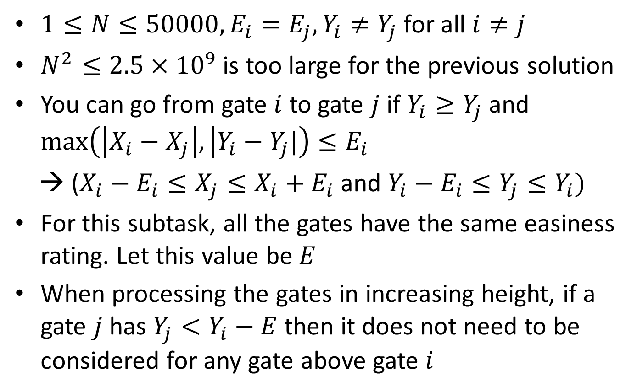
Subtask 5
$1≤N≤50000, E_{i}=E_{j}, Y_{i}≠Y_{j}$ for all $i≠j$
$N^{2}≤2.5×{10}^{9}$ is too large for the previous solution
You can go from gate $i$ to gate $j$ if $Y_{i}≥Y_{j}$ and $\max\left(\left|X_{i}−X_{j}\right|, | Y_{i}−Y_{j}|\right)≤E_{i}$
→ ($X_{i}−E_{i}≤X_{j}≤X_{i}+E_{i}$ and $Y_{i}−E_{i}≤Y_{j}≤Y_{i})$
For this subtask, all the gates have the same easiness rating. Let this value be $E$
When processing the gates in increasing height, if a gate $j$ has $Y_{j}<Y_{i}−E$ then it does not need to be considered for any gate above gate $i$

Slide 36
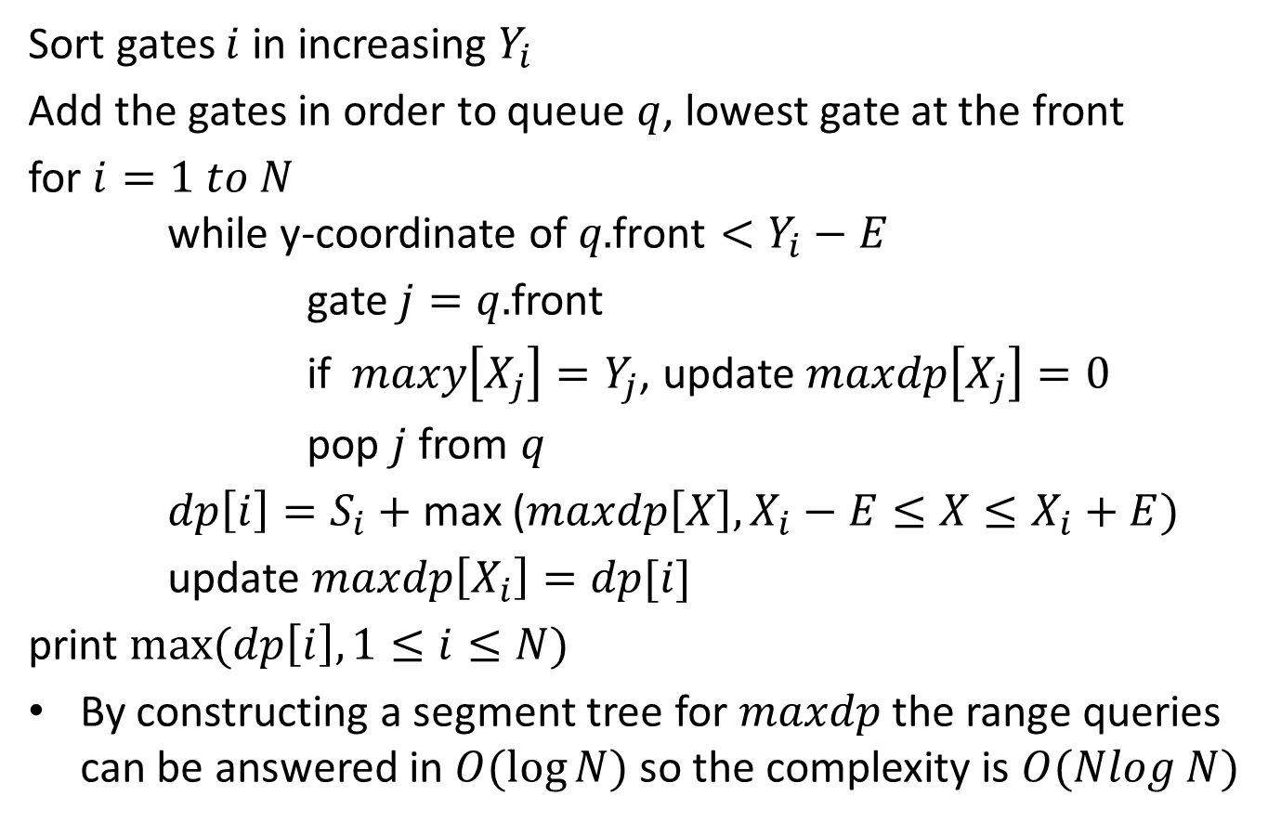
Algorithm
Sort gates $i$ in increasing $Y_{i}$
Add the gates in order to queue $q$, lowest gate at the front
for $i=1 to N$ while y-coordinate of $q\text{.}\text{front}<Y_{i}−E$
gate $j=q.$front
if$maxy\left[X_{j}\right]=Y_{j}$, update $maxdp\left[X_{j}\right]=0$
pop $j$ from $q$
$dp\left[i\right]=S_{i}+$ max ($maxdp\left[X\right], X_{i}−E≤X≤X_{i}+E)$
update $maxdp\left[X_{i}\right]=dp[i]$
print $max⁡(dp\left[i\right],1≤i≤N)$
By constructing a segment tree for $maxdp$ the range queries can be answered in $O(\log{N)}$ so the complexity is $O(Nlog N)$

Slide 37
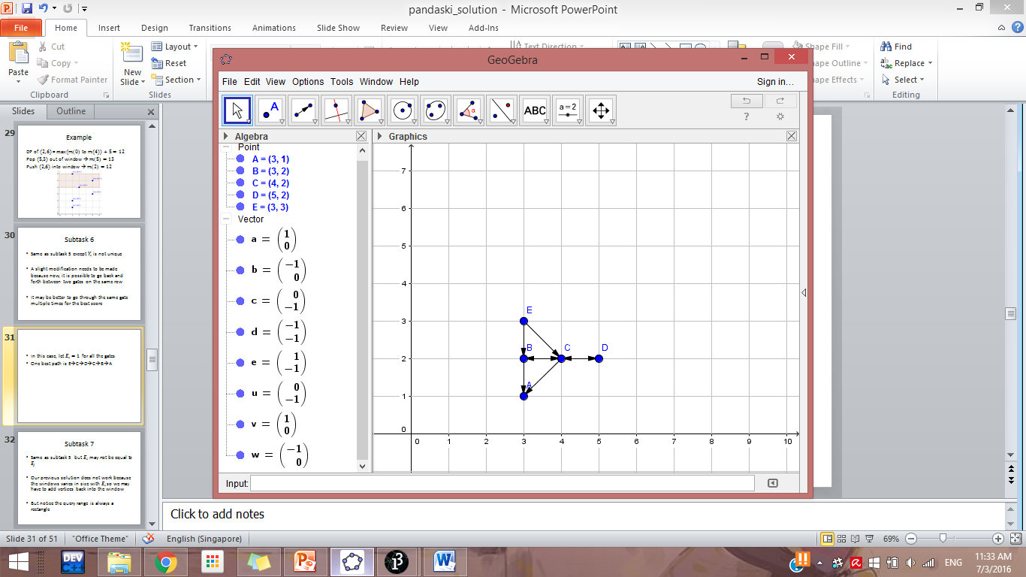
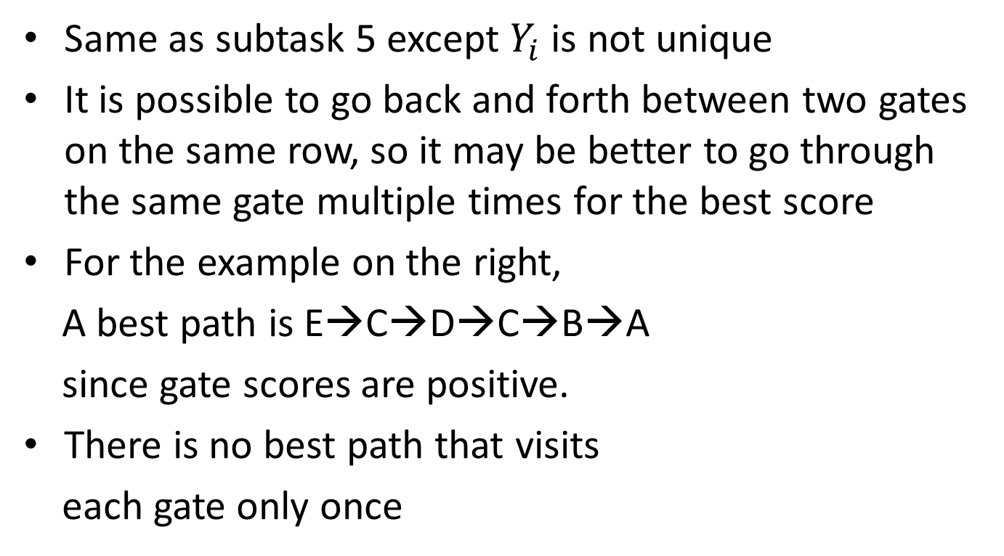
Subtask 6
Same as subtask 5 except $Y_{i}$ is not unique
It is possible to go back and forth between two gates on the same row, so it may be better to go through the same gate multiple times for the best score
For the example on the right,
A best path is E→C→D→C→B→A
since gate scores are positive.
There is no best path that visits
each gate only once

Slide 38
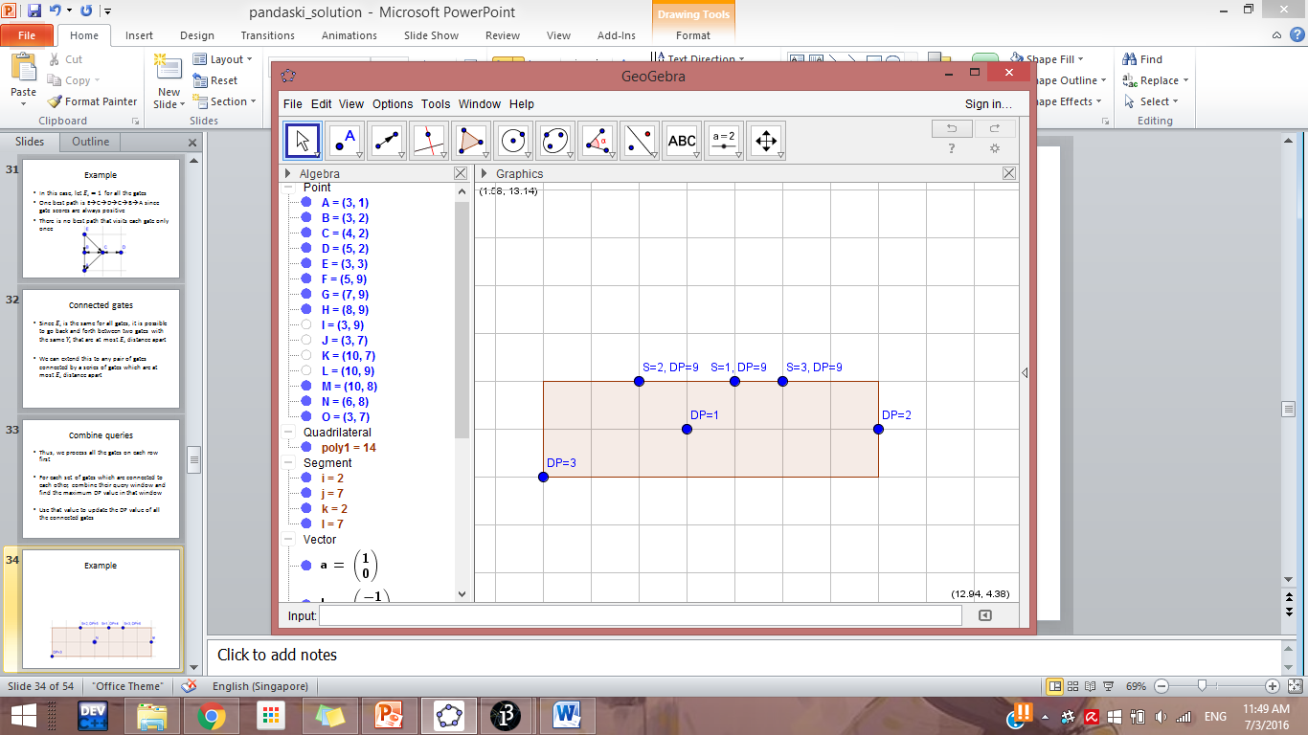
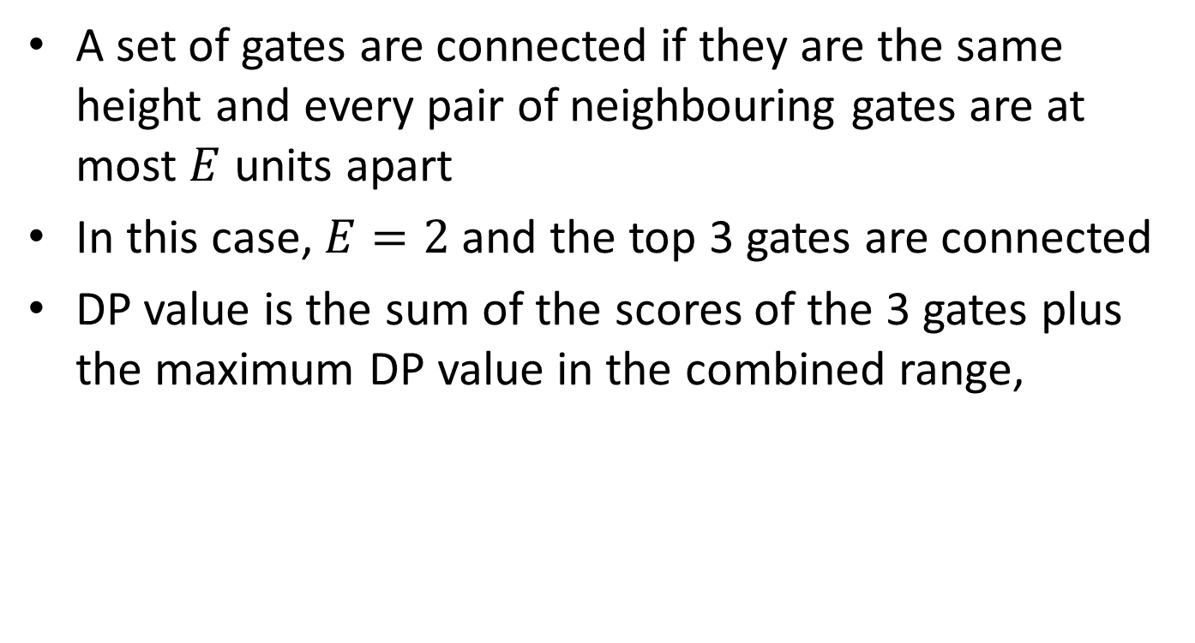
Connected gates
A set of gates are connected if they are the same height and every pair of neighbouring gates are at most $E$ units apart
In this case, $E=2$ and the top 3 gates are connected
DP value is the sum of the scores of the 3 gates plus the maximum DP value in the combined range,

Slide 39
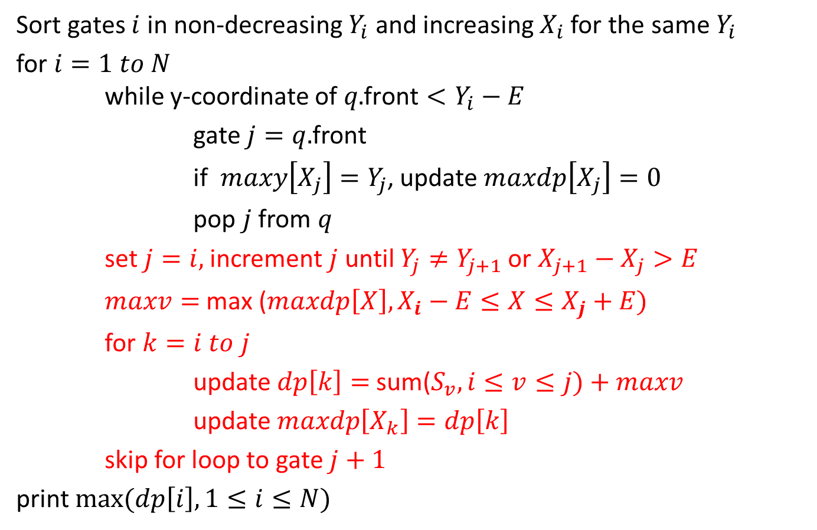
Algorithm
Sort gates $i$ in non-decreasing $Y_{i}$ and increasing $X_{i}$ for the same $Y_{i}$
for $i=1 to N$ while y-coordinate of $q\text{.}\text{front}<Y_{i}−E$
gate $j=q.$front
if$maxy\left[X_{j}\right]=Y_{j}$, update $maxdp\left[X_{j}\right]=0$
pop $j$ from $q$
set$j=i,$ increment $j$ until $Y_{j}≠Y_{j+1}$ or $X_{j+1}−X_{j}>E$
$maxv=$ max ($maxdp\left[X\right], X_{i}−E≤X≤X_{j}+E)$
for $k=i to j$
update $dp\left[k\right]=$ sum($S_{v},i≤v≤j)+maxv$
update $maxdp\left[X_{k}\right]=dp\left[k\right]$
skip for loop to gate $j+1$
print $max⁡(dp\left[i\right],1≤i≤N)$

Slide 40
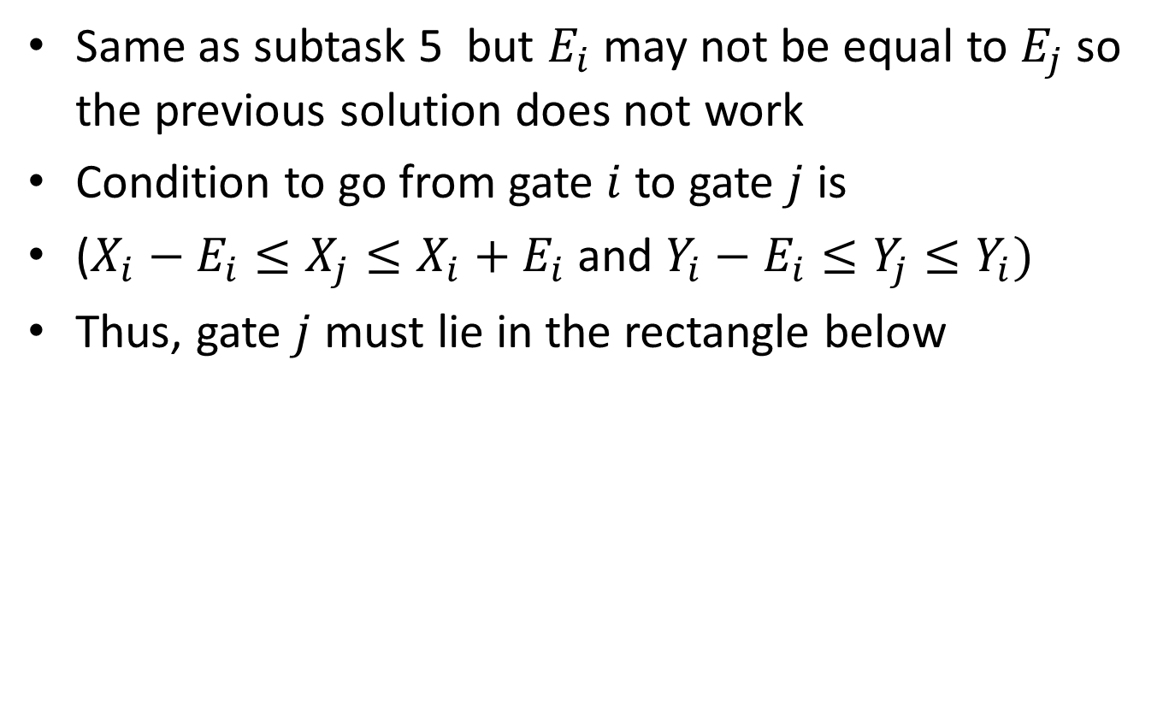
Subtask 7
Same as subtask 5 but $E_{i}$ may not be equal to $E_{j}$ so the previous solution does not work
Condition to go from gate $i$ to gate $j$ is
($X_{i}−E_{i}≤X_{j}≤X_{i}+E_{i}$ and $Y_{i}−E_{i}≤Y_{j}≤Y_{i})$
Thus, gate $j$ must lie in the rectangle below

Slide 41
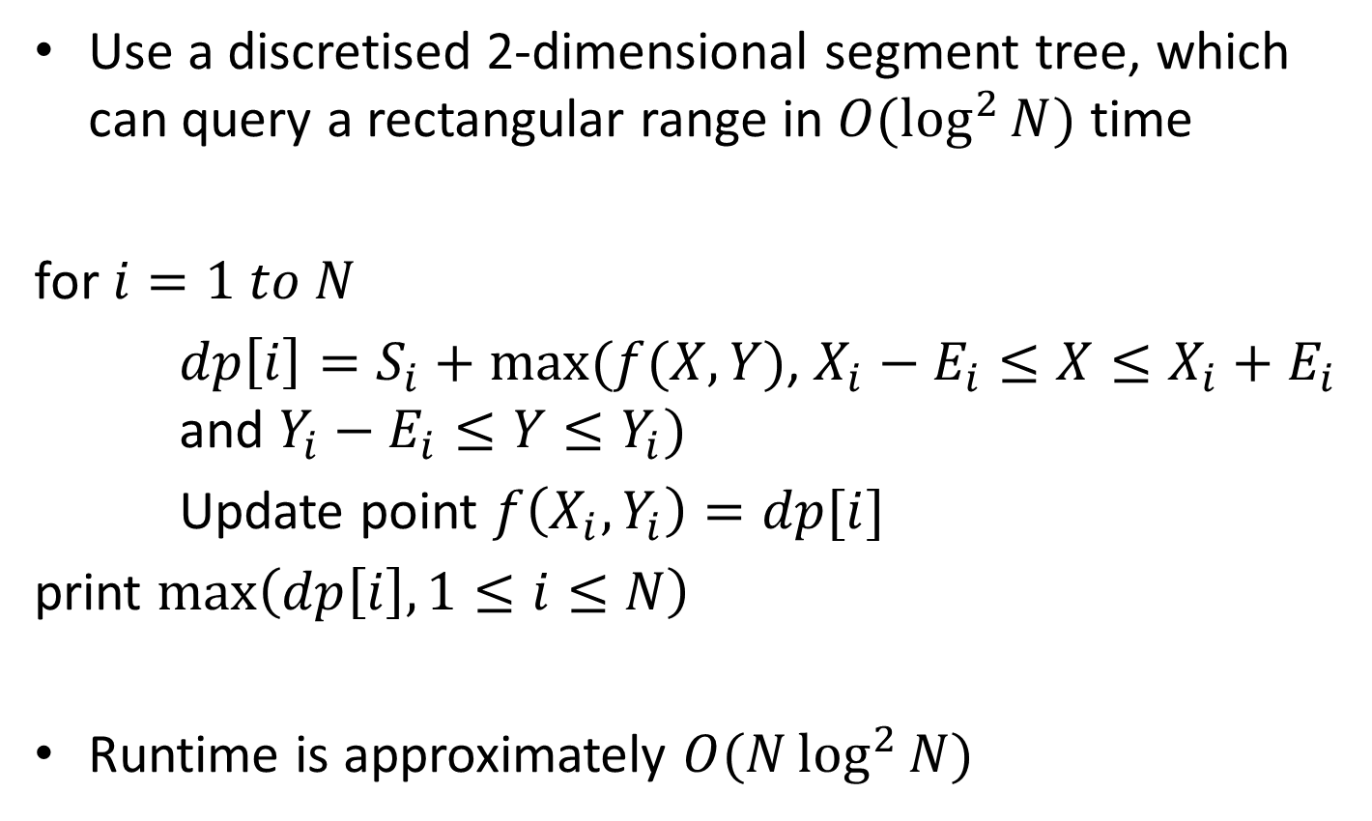
2D Segment Tree
Use a discretised 2-dimensional segment tree, which can query a rectangular range in $O(\log^{2}{N)}$ time
for $i=1 to N$
$dp\left[i\right]=S_{i}+max(f(X,Y)$, $X_{i}−E_{i}≤X≤X_{i}+E_{i}$ and $Y_{i}−E_{i}≤Y≤Y_{i})$
Update point $f\left(X_{i},Y_{i}\right)=dp[i]$
print $\max\left(dp\left[i\right],1≤i≤N\right)$
Runtime is approximately $O(N\log^{2}{N})$

Slide 42
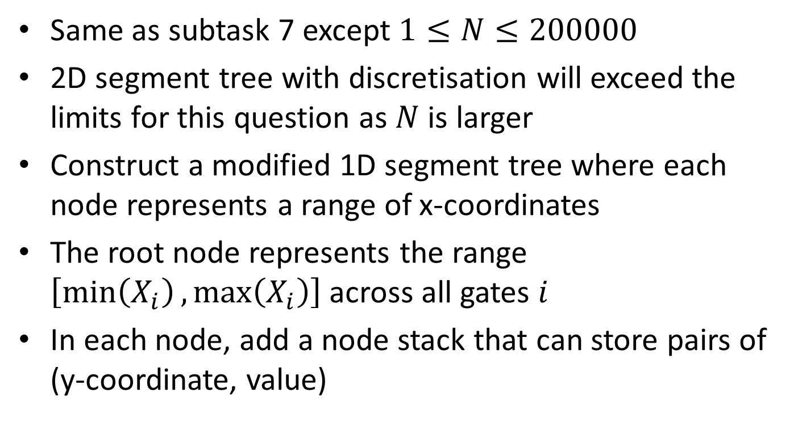
Subtask 8
Same as subtask 7 except $1≤N≤200000$
2D segment tree with discretisation will exceed the limits for this question as $N$ is larger
Construct a modified 1D segment tree where each node represents a range of x-coordinates
The root node represents the range $\left[\min\left(X_{i}\right),\max\left(X_{i}\right)\right]$ across all gates $i$
In each node, add a node stack that can store pairs of (y-coordinate, value)

Slide 43
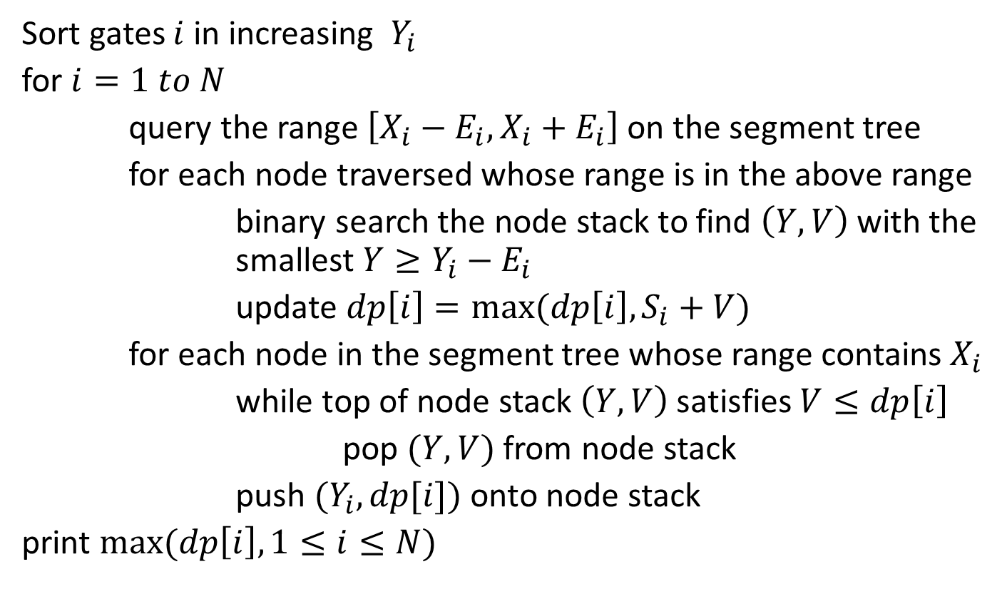
Algorithm
Sort gates $i$ in increasing $Y_{i }$
for $i=1 to N$
query the range $\left[X_{i}−E_{i},X_{i}+E_{i}\right]$ on the segment tree
for each node traversed whose range is in the above range
binary search the node stack to find $\left(Y,V\right)$ with the smallest $Y≥Y_{i}−E_{i}$
update $dp\left[i\right]=max⁡(dp\left[i\right],S_{i}+V)$
for each node in the segment tree whose range contains $X_{i}$
while top of node stack $\left(Y,V\right)$ satisfies $V≤dp\left[i\right]$
pop $(Y,V)$ from node stack
push $(Y_{i},dp[i])$ onto node stack
print $max⁡(dp\left[i\right],1≤i≤N)$

Slide 44
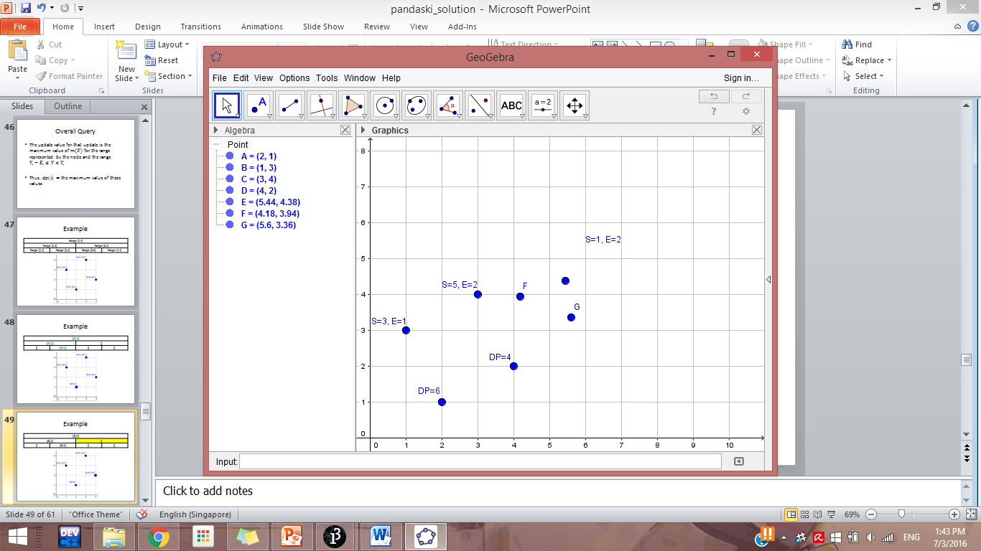
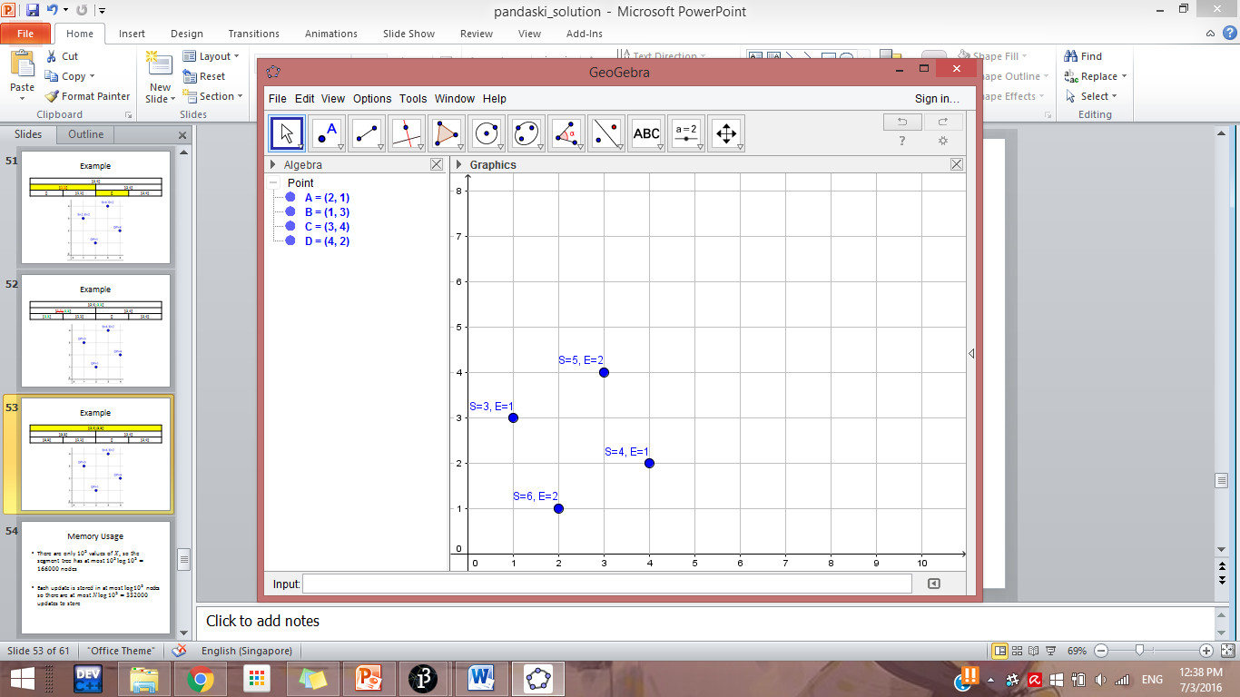
Example
Range: [1,4]
Range: [1,2] |  | Range: [3,4]
Range: [1,1] | Range: [2,2] | Range: [3,3] | Range: [4,4]

Slide 45
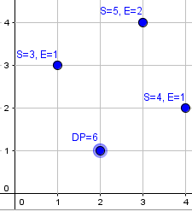
Example
[(1,6)]
[(1,6)] |  | []
[] | [(1,6)] | [] | []

Slide 46

Example
[(1,6)]
[(1,6)] |  | []
[] | [(1,6)] | [] | []

Slide 47

Example
[(1,6),(2,4)]
[(1,6)] |  | [(2,4)]
[] | [(1,6)] | [] | [(2,4)]

Slide 48


Example
[(1,6),(2,4)]
[(1,6)] |  | [(2,4)]
[] | [(1,6)] | [] | [(2,4)]

Slide 49


Example
[(1,6),(2,4),(3,3)]
[(1,6),(3,3)] |  | [(2,4)]
[(3,3)] | [(1,6)] | [] | [(2,4)]

Slide 50

Example
[(1,6),(2,4),(3,3)]
[(1,6),(3,3)] |  | [(2,4)]
[(3,3)] | [(1,6)] | [] | [(2,4)]

Slide 51

Example
[(1,6),(2,4),(3,3),(4,5)]
[(1,6),(3,3)] |  | [(2,4),(4,5)]
[(3,3)] | [(1,6)] | [(4,5)] | [(2,4)]

Slide 52

Example
[(1,6),(4,5)]
[(1,6),(3,3)] |  | [(2,4),(4,5)]
[(3,3)] | [(1,6)] | [(4,5)] | [(2,4)]

Slide 53

Time Complexity
Let $\max\left(X_{i}\right)−\min\left(X_{i}\right)=W ,$each update is stored in at most $\log{W}$ nodes so the total number of updates stored is $N\log{W}$
Each update is pushed and popped at most once so overall complexity for updates is $O(N\log{W)}$
Each query on the segment tree requires a $\log{N}$ binary search on $\log{W}$ nodes
So the overall complexity for the queries $O(N\log{W\log{N)}}$

Slide 54
Conclusion
The solution presented in subtask 8 will not earn full credit since it cannot handle the case of connected gates
Need to combine with solution from subtask 6 to get the full credit
Due to time constraints, details of how and why the algorithms work have been omitted
Proof of methods and theorems used have also been omitted, this shall be left as an exercise

Slide 55
Task 5: Unlucky floors
Author: Ranald Lam

Slide 56
Problem Summary
Conventional numbering schemes are positive integers
Lucky numbering scheme omits numbers with ‘4’ and ‘13’
Conventional
6
5
4
3
2
1
Lucky
7
6
5
3
2
1
← Convert →

Slide 57

Subtask 1: Print answer
Floor numbers are up to 25
Answer for up to 20 is provided in the statement
Manually solve the remaining 5
Code using “Answer array” or if-else statements

Slide 58
Subtask 2: String Processing
We define unlucky numbers as those that contain either a ‘4’ or ‘13’
To check if a number is unlucky:
Convert the number into individual digits (using sprintf/stringstream/base conversion)
Loop through each digit to check for presence of ‘4’
Loop through each consecutive pair of digits to check for presence of ’13’
Loop through from 1 onwards, count the number of unlucky numbers to calculate the answer

Slide 59
Subtask 2: String Processing
bool unlucky(long long x) {
char str[20];
sprintf(str, "%lld", x);
for (int i = 0, l = strlen(str); i < l; i++) {
if (str[i] == '4') return 1;
if (i == 0) continue;
if (str[i-1] == '1' && str[i] == '3') return 1;
}
return 0;
}

Slide 60
Subtask 3: String Processing + Counter
Maintain 2 counters: 1 for conventional, 1 for lucky
for (int c = 1, l = 1; c <= 100000; c++, l++) {
while (unlucky(l)) l++;
lucky_to_conv[l] = c;
conv_to_lucky[c] = l;
}

Slide 61

Subtask 4 Method 1: Manual / Pattern Recognition
Find a formula then compute by hand manually
k | 10^{k}-1 | f(k)
1 | 9 | 8
2 | 99 | 79
3 | 999 | 710 | (79-8)*10
4 | 9999 | 6318 | (710-79)*10+8
5 | 99999 | 56159 | (6318-710)*10+79
6 | 999999 | 499120 | (56159-6318)*10+710
k | 10^{k}-1 | f(k) = | (f(k-1) – f(k-2))*10 + f(k-3)

Slide 62

Subtask 4 Method 2: Dynamic Programming
Use dynamic programming to count number of lucky numbers for each digit
$dp\left(p, d\right)$: no. of lucky numbers with p digits and d as first digit

Slide 63
Subtask 4
1st digit
2nd digit
3rd digit
1
1, 2, 5, 6, 7, 8, 9, 0
2
1, 2, 3, 5, 6, 7, 8, 9, 0
3
1, 2, 3, 5, 6, 7, 8, 9, 0
5
1, 2, 3, 5, 6, 7, 8, 9, 0
7
6
1, 2, 3, 5, 6, 7, 8, 9, 0
7
1, 2, 3, 5, 6, 7, 8, 9, 0
8
1, 2, 3, 5, 6, 7, 8, 9, 0
Counts how many lucky numbers with:
exactly 3 digits
starting with 7
9
1, 2, 3, 5, 6, 7, 8, 9, 0
0
1, 2, 3, 5, 6, 7, 8, 9, 0

Slide 64
Subtask 4
1st digit
2nd digit
3rd digit
1
1, 2, 5, 6, 7, 8, 9, 0
2
1, 2, 3, 5, 6, 7, 8, 9, 0
5
1, 2, 3, 5, 6, 7, 8, 9, 0
1
6
1, 2, 3, 5, 6, 7, 8, 9, 0
7
1, 2, 3, 5, 6, 7, 8, 9, 0
8
1, 2, 3, 5, 6, 7, 8, 9, 0
Counts how many lucky numbers with:
exactly 3 digits
starting with 1
9
1, 2, 3, 5, 6, 7, 8, 9, 0
0
1, 2, 3, 5, 6, 7, 8, 9, 0

Slide 65
Subtask 4
1st digit
2nd digit
3rd digit
1
1, 2, 5, 6, 7, 8, 9, 0
2
1, 2, 3, 5, 6, 7, 8, 9, 0
1
3
1, 2, 3, 5, 6, 7, 8, 9, 0
5
1, 2, 3, 5, 6, 7, 8, 9, 0
Overlapping subproblems!
6
1, 2, 3, 5, 6, 7, 8, 9, 0
7
7
1, 2, 3, 5, 6, 7, 8, 9, 0
8
1, 2, 3, 5, 6, 7, 8, 9, 0
9
1, 2, 3, 5, 6, 7, 8, 9, 0
0
1, 2, 3, 5, 6, 7, 8, 9, 0

Slide 66
Subtask 4
1st digit
2nd digit
3rd digit
1
1
2
2
1
3
3
5
5
Overlapping subproblems!
6
6
7
7
7
8
8
9
9
0
0

Slide 67

Subtask 4: Dynamic Programming
$dp\left(p, d\right)$: no. of lucky numbers with p digits and d as first digit
Base Cases
$dp\left(p, 4\right)=0$
Any number with 4 isn’t a lucky number
$dp\left(1, 0\right)=0$
0 is not a lucky number
$dp\left(1, d\right)=1$
Any number with 1 digit is a lucky number (other than 4 and 0)

Slide 68

Subtask 4: Dynamic Programming
$dp\left(p, d\right)$: no. of lucky numbers with p digits and d as first digit
Transition
$dp\left(p, d\right)$=
if d is 1
$\sum_{i}{dp\left(p−1, i\right)}$ where $i∈\{0, 1, 2, 5, 6, 7, 8, 9\}$
if d is not 1
$\sum_{i}{dp\left(p−1, i\right)}$ where $i∈\{0, 1, 2, 3, 5, 6, 7, 8, 9\}$
Computing Answer
If $Xi$ has $K$ digits and of the form $10K−1$
$\sum_{i=0}^{9}{dp\left(K, i\right)}$

Slide 69
Subtask 5
We need a more efficient way of counting lucky numbers
What if we break it down into digits?
If the current digit is 7, what are the possible next digits?
0, 1, 2, 3, 5, 6, 7, 8, 9
If the current digit is 1, what are the possible next digits?
0, 1, 2, 5, 6, 7, 8, 9
If the current digit is 4, what are the possible next digits?
None! (No lucky number can be formed)

Slide 70

Subtask 5
$Xi$ = 257
1
1, 2, 5, 6, 7, 8, 9, 0
2
1, 2, 3, 5, 6, 7, 8, 9, 0
1
3
1, 2, 3, 5, 6, 7, 8, 9, 0
5
1, 2, 3, 5, 6, 7, 8, 9, 0
6
1, 2, 3, 5, 6, 7, 8, 9, 0
7
1, 2, 3, 5, 6, 7, 8, 9, 0
8
1, 2, 3, 5, 6, 7, 8, 9, 0
Counts how many lucky numbers with:
exactly 3 digits
starting with 1
9
1, 2, 3, 5, 6, 7, 8, 9, 0
0
1, 2, 3, 5, 6, 7, 8, 9, 0

Slide 71


Subtask 5
$Xi$ = 257
1
1, 2, 5, 6, 7, 8, 9, 0
Bounded by the digits of $Xi$
2
1, 2, 3, 5, 6, 7, 8, 9, 0
3
1, 2, 3, 5, 6, 7, 8, 9, 0
5
1, 2, 3, 5, 6, 7
2
Counts how many lucky numbers with:
exactly 3 digits
starting with 2
Not more than $Xi$
Counts how many lucky numbers with:
exactly 3 digits
starting with 25
Not more than $Xi$

Slide 72

Subtask 5
1
1, 2, 5, 6, 7, 8, 9, 0
$Xi$ = 257
2
1, 2, 3, 5, 6, 7, 8, 9, 0
3
1, 2, 3, 5, 6, 7, 8, 9, 0
5
1, 2, 3, 5, 6, 7, 8, 9, 0
1
6
1, 2, 3, 5, 6, 7, 8, 9, 0
7
1, 2, 3, 5, 6, 7, 8, 9, 0
8
1, 2, 3, 5, 6, 7, 8, 9, 0
9
1, 2, 3, 5, 6, 7, 8, 9, 0
0
1, 2, 3, 5, 6, 7, 8, 9, 0
Bounded by the digits of $Xi$
2
5
1, 2, 3, 5, 6, 7

Slide 73


Subtask 5: Dynamic Programming
State
$dp\left(p, d, isBound\right)$
no. of lucky numbers with p digits and d as first digit
$isBound$indicates whether the next digit is bounded by $Xi$
Blue represents $isSame=0$
Yellow represents $isSame=1$
$dp\left(p, d, 0\right)$
number of lucky numbers with p digits and d as first digit
$dp\left(p, d, 1\right)$
number of lucky numbers with p digits, d as first digit
However, next digit is bounded by $Xi$
$Xi$ = 5287 and dp(3, 2, 1) will mean that the next digit cannot be more than 8
$$dp\left(p, d, 0\right)$$
$$dp\left(p, d, 1\right)$$

Slide 74
Subtask 5: Dynamic Programming
State
$dp\left(p, d, isBound\right)$
no. of lucky numbers with p digits and d as first digit
$isBound$indicates whether the next digit is bounded by $Xi$
Base Cases
$dp\left(p, 4, 0\right)=dp\left(p, 4, 1\right)=0$
Any number with 4 isn’t a lucky number
$dp\left(1, 0, 0\right)=dp\left(1, 0, 1\right)=0$
0 is not a lucky number
$dp\left(1, d, 0\right)=dp\left(1, d, 1\right)=1$
Any number with 1 digit is a lucky number (other than 4 and 0)

Slide 75

Subtask 5: Dynamic Programming
State
$dp\left(p, d, isBound\right)$
no. of lucky numbers with p digits and d as first digit
$isBound$indicates whether the next digit is bounded by $Xi$
Transitions (Blue Boxes)
$dp\left(p, d, 0\right)$=
if d is 1
$\sum_{i}{dp\left(p−1, i, 0\right)}$ where $i∈\{0, 1, 2, 5, 6, 7, 8, 9\}$
if d is not 1
$\sum_{i}{dp\left(p−1, i, 0\right)}$ where $i∈\{0, 1, 2, 3, 5, 6, 7, 8, 9\}$
$$dp\left(p, d, 0\right)$$

Slide 76


Subtask 5: Dynamic Programming
State
$dp\left(p, d, isBound\right)$
no. of lucky numbers with p digits and d as first digit
$isBound$indicates whether the next digit is bounded by $Xi$
Transitions (Yellow Boxes)
Let $n= p−1th digit of Xi$ (next digit)
$dp\left(p, d, 1\right)$=
if d is 1
$\sum_{i}{dp\left(p−1, i, 0\right)}$ where $i∈\left\{0, 1, 2, 5, 6, 7, 8, 9\right\} and i<n+$
$dp\left(p−1,n, 1\right)$ if $n∈\left\{0, 1, 2, 5, 6, 7, 8, 9\right\}$
if d is not 1
$\sum_{i}{dp\left(p−1, i, 0\right)}$ where $i∈\left\{0, 1, 2, 3, 5, 6, 7, 8, 9\right\}, and i<p−1th digit of Xi+$
$dp\left(p−1,n, 1\right) \text{if} n∈\left\{0, 1, 2, 3, 5, 6, 7, 8, 9\right\}$
$$dp\left(p, d, 1\right)$$

Slide 77
Subtask 5: Dynamic Programming
Computing Answer
If $Xi$ has $K$ digits with the first digit being $n$
$\sum_{i=0}^{n−1}{dp\left(K, i, 0\right)}+ dp\left(K, n, 1\right)$

Slide 78

Subtask 6: Binary Search the Answer
For $Ti=1$
Use Subtask 5’s solution
For $Ti=2$
Binary Search the Answer
Guess a certain floor in the lucky numbering scheme
Convert it to conventional to check
If guess is too high, the answer must be lower
If guess is too low, the answer must be higher
Verify using Subtask 5’s solution (but with inputs up to 7.7*10¹⁷)
18 digits total

Slide 79
Subtask 6
Subtask 5’s solution might not be fast enough for Subtask 6
Current Runtime: O(N * states * avg. transition * log₂ 10¹⁸)
Estimated iterations: 100000 * (18 * 10 * 2) * 10 * 60 = 2.16 x 10¹⁰ iterations
Constant time optimisations might be required
Reduction of DP states
Reduction of DP transition
Reduce recalculation of DP states

Slide 80

Subtask 6
Observation 1
$dp\left(p, d, 0\right)$ states do not need to be recomputed for every $Xi$
“Blue” states are not bounded by $Xi$
Only $\log_{10}{Xi}+1$ states to calculate per $Xi$
“Yellow” states
$dp\left(p, d, 0\right)$ states can be pre-computed at the start of the program

Slide 81
Subtask 6
Observation 2
$dp\left(p, d, 0\right)$ states have the same transition when $d≠1 or 4$
if d is 4
0 (base case)
if d is 1
$\sum_{i}{dp\left(p−1, i, 0\right)}$ where $i∈\{0, 1, 2, 5, 6, 7, 8, 9\}$
if d is not 1
$\sum_{i}{dp\left(p−1, i, 0\right)}$ where $i∈\{0, 1, 2, 3, 5, 6, 7, 8, 9\}$
They thus have the same value

Slide 82

Subtask 6
Observation 2
Transition for $dp\left(p, d, 1\right)$ states can be reduced to a linear combination of
$dp\left(p−1, 0, 0\right)$
$dp\left(p−1, 1, 0\right)$
$dp\left(p−1, 0, 1\right)$
$dp\left(p−1, 1, 1\right)$
Number of states can be reduced
p from 1 to 18
d = 0 or 1
isBound = 0 or 1

Slide 83
Subtask 6
Constant time optimisation reduces runtime to the following
Runtime: O(N * states * avg. transition * log₂ 10¹⁸)
Estimated iterations: 100000 * 18 * 4 * 60 = 4.32 x 10⁸ iterations
Disclaimer
It is possible to obtain full marks for this problem via other means of reducing constant time

